Slide 1
Heroes of Faith
New Testament Period
New Testament Period
Faith in Action – Part I

Slide 2
Introduction:
The book of Acts is our first record of church history and comes on the heels of what has been considered the final words of Jesus prior to His ascension to heaven; “but you shall receive power when the Holy Spirit has come upon you, and you shall be witnesses to Me in Jerusalem, and in all Judea, and Samaria, and to the ends of the earth.” (Acts 1:8)

Slide 3
Introduction:
The Book of Acts:
  Is a record of what transpired over the first 30 years of the church and is in response to the command of Jesus Christ to go and preach the gospel when He said; “All authority is given to me in heaven and on earth. Go therefore and make disciples of all nations, baptizing them in the name of the Father, and the Son, and the Holy Spirit, teaching them to observe all that I have commanded you, and lo I am with you always, even to the end of the age” (Matthew 28:18-20)

Slide 4
Introduction:
The Book of Acts:
  What is also taught in this book is the central doctrine and core teaching of the apostles that Jesus is the long awaited Messiah and the only way to the Father. Peter will declare this to the religious leaders of his time; “And there is salvation in no one else; for there is no other name under heaven that has been given among men by which we must be saved” (Acts 4:12)

Slide 5
Introduction:
The book of Acts is somewhat of a transitional book
  The Scriptures move from the teachings of Jesus (recorded in the 4 gospels) to the teaching of the apostles and that teaching is the same.
  All authority rested with Jesus Christ and He passes that authority to the apostles through the power of the Holy Spirit. This is recorded in the book of Acts.

Slide 6
Here are a few highlights of the early days of the church:
The day of Pentecost, in which the miraculous works of the Holy Spirit were evidenced and the subsequent outward manifestation of His power as seen through the various acts/works of the apostles. (Acts 2:1-13)

Slide 7
Here are a few highlights of the early days of the church:
Peter’s dynamic sermon in Acts 2:14-36 in which he declares:
  “Men of Israel, listen to these words: Jesus the Nazarene, a man attested to you by God with miracles and wonders and signs which God performed through Him in your midst, just as you yourselves know – this Man, delivered over by the predetermined plan and foreknowledge of God, you nailed to a cross by the hands of godless men and put Him to death. But God raised Him up again, putting an end to the agony of death, since it was impossible for Him to be held in its power” (Acts 2:22-24)

Slide 8
Here are a few highlights of the early days of the church:
Peter’s dynamic sermon in Acts 2:14-36 in which he declares:
  “This Jesus, God raised up again, to which we are all witnesses. Therefore having been exalted to the right hand of God, and having received from the Father the promise of the Holy Spirit, He has poured forth this which you both see and hear” (Acts 2:32-33)
  “Therefore let all the house of Israel know for certain that God has made Him both Lord and Christ – this Jesus whom you crucified” (Acts 2:34)

Slide 9
Here are a few highlights of the early days of the church:
The church grew rapidly:
  “So then, those who received his word were baptized; and that day there were added about three thousand souls. They were continually devoting themselves to the apostles teaching and to fellowship, to the breaking of bread and to prayer” (Acts 2:41-42)
  “Day by day continuing with one mind in the temple, and breaking bread from house to house, they were taking their meals together with gladness and sincerity of heart, praising God and having favor with all the people. And the Lord was adding to their number day by day those who were being saved” (Acts 2:46-47)

Slide 10
Here are a few highlights of the early days of the church:
The healing of the beggar who was lame; “But Peter said, I do not possess silver and gold, but what I do have I give to you. In the name of Jesus Christ the Nazarene – walk! And seizing him by the right hand, he raised him up; and immediately his feet and ankles were strengthened. With a leap he stood upright and began to walk; and he entered the temple with them, walking and leaping and praising God” (Acts 3:6-8)

Slide 11
Here are a few highlights of the early days of the church:
Peter’s second sermon (Acts 3:11-26)
  “Men of Israel, why are you amazed at this, or why do you gaze at us, as if by our own power or piety we had made him walk?” (Acts 3:12)
  “The God of Abraham, Isaac and Jacob, the God of our fathers, has glorified His servant Jesus, the one whom you delivered and disowned in the presence of Pilate when he had decided to release Him. But you disowned the Holy and Righteous One and asked for a murdered to be granted to you, but put to death the Prince of life, the One whom God raised from the dead, a fact to which we are witnesses” (Acts 3:13-15)

Slide 12
Here are a few highlights of the early days of the church:
Peter’s second sermon (Acts 3:11-26)
  “And on the basis of faith in His name, it is the name of Jesus which has strengthened this man whom you see and know; and the faith which comes through Him has given this perfect health in the presence of you all” (Acts 3:16)
  “Therefore repent and return, so that your sins may be wiped away, in order that times of refreshing may come from the presence of the Lord” (Acts 3:19)

Slide 13
Here are a few highlights of the early days of the church:
The first arrest of Peter and John for preaching the gospel (Acts 4)
  This begins a series of confrontations with the religious leaders of the temple in Jerusalem in which they totally object to the teaching about Jesus Christ (specifically about His resurrection) by the apostles. (Acts 4:1-2)
  “Peter and John are subsequently thrown in jail for preaching (Acts 4:3)
  The Sanhedrin is convened and they warn the apostles to stop preaching about Jesus – but they don’t and the church grows even larger. (Acts 4:4-37)

Slide 14
Here are a few highlights of the early days of the church:
There is a second incarceration in which all 12 apostles are thrown in jail and the Lord miraculously opens the gates of the prison allowing them all to be free.
  Upon leaving the prison, the apostles do as they were commanded by the Lord and go out into the city and preach the gospel.
  There was a great deal of confusion by the guards and religious leaders as to how the apostles were able to get out of prison.
  The Sanhedrin reconvened and once again instructed the apostles to stop preaching about Jesus.

Slide 15
Here are a few highlights of the early days of the church:
Peter and the other apostles responded with these words; “We must obey God rather than men. The God of our fathers raised up Jesus, whom you had put to death by hanging Him on a cross. He is the one whom God exalted to His right hand as a Prince and a Savior, to grant repentance to Israel, and forgiveness of sins. And we are witnesses of these things, and so is the Holy Spirit, whom God has given to those who obey Him” (Acts 5:29-32)

Slide 16
Here are a few highlights of the early days of the church:
Gamaliel (a well-respected Pharisee and teacher) said this to the members of the Sanhedrin in response to the actions and words of the apostles; “So in the present case, I say to you, stay away from these men and let them alone, for if this plan or action is of men it will be overthrown; but if it is of God, you will not be able to overthrow them; or else you may even be found fighting against God” (Acts 5:38-39)

Slide 17
Here are a few highlights of the early days of the church:
The apostles were released and this is what Luke records took place after; “So they went on their way from the presence of the council rejoicing that they had been considered worthy to suffer shame for His name. And every day they kept right on teaching and preaching Jesus as the Christ” (Acts 5:41-42)

Slide 18
Here are a few highlights of the early days of the church:
The Jerusalem church experiences enormous growth and the need to effectively minister to all those who are coming to faith in Jesus became an important component that the apostles needed to address. The decision was made (Acts 6) to delegate the daily affairs (shepherding duties) to others who were gifted to perform those tasks so the apostles could devote themselves to prayer and preaching the Word. This immense growth of the church also brought added persecution.

Slide 19
The Church Expands:
After the decision to appoint seven men of good reputation to handle more of the administrative affairs of the church in Jerusalem; things continued to grow.
“The word of God kept on spreading; and the number of disciples continued to increase greatly in Jerusalem, and a great many of the priests were becoming obedient to the faith” (Acts 6:7)

Slide 20
The Church Expands:
Stephen; one of the seven who were appointed for this task, became a target of persecution because of his preaching.
  “And Stephen, full of grace and power, was performing great wonders and signs among the people” (Acts 6:8)

Slide 21
The Church Expands:
Stephen:
  His preaching about Jesus was not popular with some people; “But they were unable to cope with the wisdom and the Spirit with which he was speaking. Then they secretly induced men to say, we have heard him speak blasphemous words against Moses and against God. And they stirred up the people, the elders and the scribes, and they came up to him and dragged him away and brought him before the Council.” (Acts 6:1-12)

Slide 22
The Church Expands:
Stephen:
  Stephen will defend his actions and preach one of the finest sermons ever declared, but it will infuriate the members of the Sanhedrin which results in him being stoned to death. (Acts 7:54-60)

Slide 23
The Church Expands:
All of this attention surrounding the Jerusalem church brings about an immense amount of opposition from those who didn’t agree with the message that Jesus rose from the dead and was the only Way to God.
The Jewish religious leaders will engage a man whose name was Saul of Tarsus to hunt down and arrest these ones who were preaching about Jesus. The Lord will intervene and Saul (also known as Paul) will submit to Jesus and his ministry will spread throughout the Gentile world. We’ll look at his life in our next lesson.

Slide 24
The Church Expands:
As the persecution of the church intensified in Jerusalem; it caused the apostles and others to go to Judea, Samaria and eventually to the uttermost parts of the earth.

Slide 25
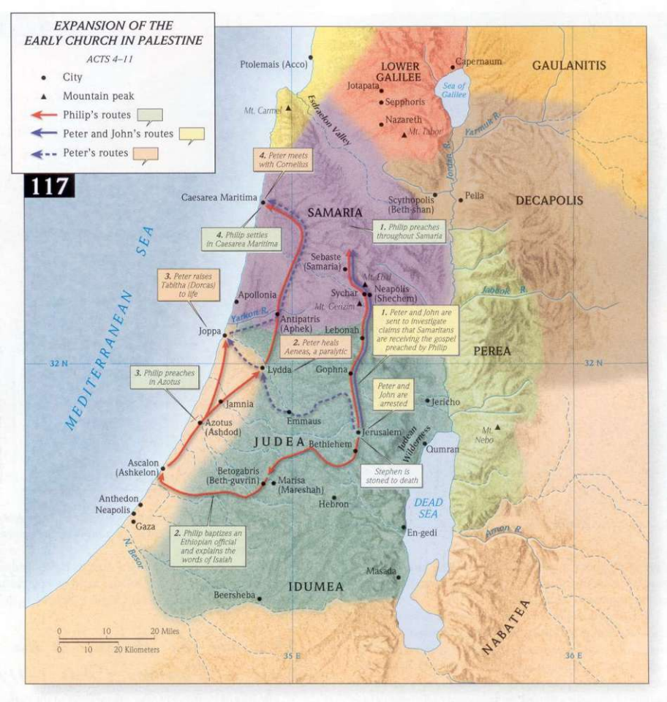
The Church Expands:
Taking the Gospel to Judea, Samaria and beyond (Acts 8-11)

Slide 26
The Church Expands:
The gospel also spread to the region of Antioch (Syria)
  “So then those who were scattered because of the persecutions that occurred in connection with Stephen made their way to Phoenicia and Cyprus, and Antioch, speaking the word to no one except to Jews alone. But there were some of them, men of Cyprus and Cyrene, who came to Antioch and began speaking to the Greeks also, preaching the Lord Jesus. And the hand of the Lord was with them, and a large number who believed turned to the Lord” (Acts 11:19-21)

Slide 27
The Church Expands:
The gospel also spread to the region of Antioch (Syria)
  It was at Antioch where the disciples were first called Christians (“little Christ’s”) which identified them as followers of Jesus. (Acts 11:26)
  Antioch also became the sending church for the missionary activity of Paul and Barnabas as the Gospel spreads to the uttermost regions of the world (Acts 13:1-3)

Slide 28
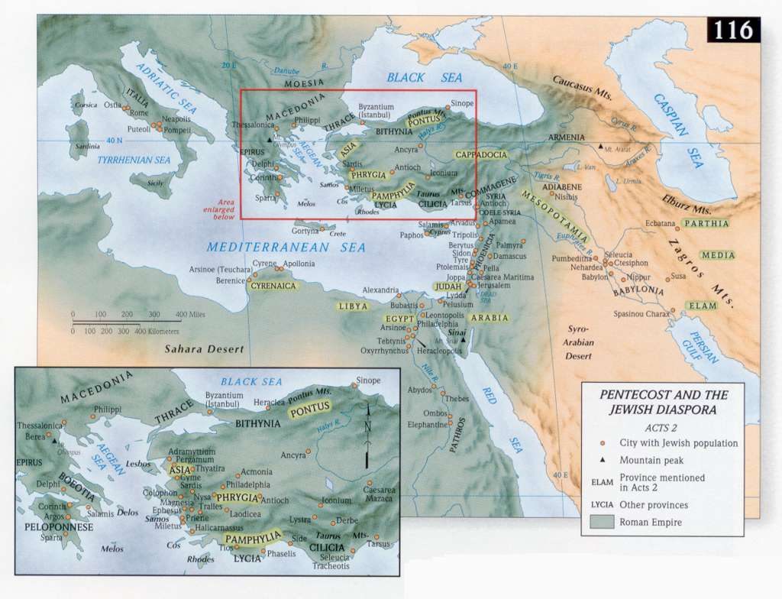
The Ministry of the Apostles

Slide 29
Simon (Peter)
He was born in Bethsaida in Galilee
  His father was Jona
  His brother Andrew also became an apostle

Slide 30
Simon (Peter)
He became a fisherman just like his father and eventually partnered up with his brother and another fisherman by the name of Zebedee along with his two sons James and John. These are the same two men (James and John) who also follow Christ and are later referred to as apostles.
Peter faithfully follows Jesus along with the other 12
Peter makes this bold declaration about Jesus; “You are the Christ the Son of the Living God” (Matthew 16:16)

Slide 31
Simon (Peter)
Here are some of the significant works of Peter that are recorded through the first four chapter of Acts:
  He preaches to the masses in Jerusalem on the Day of Pentecost. (Acts 2)
  He was used by God in the healing of a man who had been crippled since birth. In response to the request for alms from the crippled man; Peter responds with the powerful declaration; “I do not possess silver and gold, but what I do have I give to you: In the name of Jesus Christ the Nazarene – walk” (Acts 3:6 - NASB)

Slide 32
Simon (Peter)
Here are some of the significant works of Peter that are recorded through the first four chapter of Acts:
  Peter continues to preach the Gospel and suffers persecution from the Jewish leaders. His second sermon is recorded in Acts 3.
  Peter is subsequently arrested for preaching and refuses to stop declaring that; “There is salvation in no one else; there is no other name under heaven that has been given among men by which we must be saved”. (Acts 4:12 – NASB)

Slide 33
Simon (Peter)
Peter begins to travel throughout the region of Judea where he will witness and confirm that Gentiles were coming to faith in Jesus
  He will be used by God to heal a paralytic man named Aeneas (Acts 9:32-35). This took place in the town called Lydda which is modern day Lod (close to Tel Aviv).
  From Lydda; Peter will travel to Joppa and the Lord will use him to raise a woman by the name of Dorcas (Tabitha) back from the dead. (Acts 9:36-43)

Slide 34
Simon (Peter)
Peter begins to travel throughout the region of Judea where he will witness and confirm that Gentiles were coming to faith in Jesus
  Acts 10 records the account of the vision by Cornelius and Peter that results in the acceptance of Gentiles becoming converts to Christianity..
  This will spark great controversy but in the end it will be Peter who is instrumental in helping to solve the dispute over whether Gentiles could be saved. (Acts 11)

Slide 35


Slide 36
Simon (Peter)
Peter will return to Jerusalem and helps to get the discussion going to help resolve the conflict over whether Gentile converts needed to be circumcised in order to be saved. The decision is made that they do not need to be circumcised but should abstain from their former pagan practices. (Acts 15:19-20, 28-29)

Slide 37
Simon (Peter)
Other noteworthy events in the life of Peter the apostle
  Due to the emergence of persecution and various imprisonments from the Jewish religious leaders as well as various Roman leaders; Peter will leave the territory of Judea and minister in various regions of the Middle East and eventually find his way to Rome.
  He will write the Epistle of I Peter
  Peter’s second Epistle is a more direct plea to guard against false teachers and prepare for persecution from all fronts.

Slide 38
Simon (Peter)
Peter’s ministry in Rome
  While he is in Rome he will help to establish/strengthen the church there
  While in Rome he will influence/mentor Mark who will write our earliest Gospel account of the ministry of Jesus. It is believed that Peter will dictate his own first-hand account of the life of Jesus which is known to us as the Gospel of Mark.

Slide 39
Simon (Peter)
Peter’s final days
  Peter spent his last day in a prison called the Mamertine prison. Tradition claims he was incarcerated for nine months and forced to remain in an upright position chained to a column.
  Church tradition also claims that Peter was crucified upside down by order of the Emperor Nero.
  The traditional date for Peter’s death was 67 or 68 A.D.

Slide 40
Andrew
His birth and occupation
  He was the brother of Simon (Peter) and his father was Jona (John)
  His occupation was a fisherman
  He was a disciple of John the Baptist before following Christ

Slide 41
Andrew
He was the first of the Apostles to follow Christ (John 1:35-42) and was instrumental in introducing Peter and others to Christ.
  You will find him mentioned in a few places in the Gospel accounts
  The only place he is mentioned in the Book of Acts is in the list of the apostles and he is not mentioned in any of the Epistles or Revelation

Slide 42
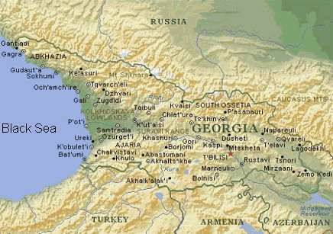
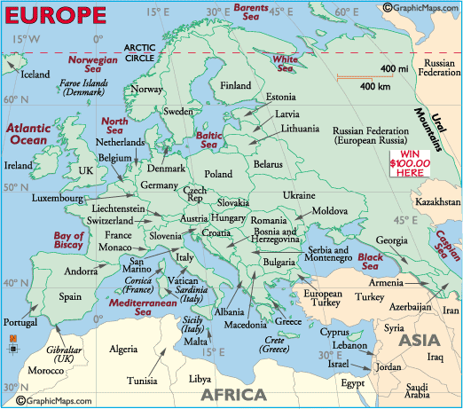
Andrew
Andrew settled in the foothills of the Caucasus Mountains (present day Georgia in Russia), and while there he ministered to the Scythians.

Slide 43
Andrew
Notable contributions from the apostle Andrew (according to church tradition)
  It is also believed that he (like Paul) had an itinerant ministry as he traveled to Byzantium (modern day Istanbul, Turkey), then to Greece, Thrace and Macedonia.
  He eventually ends up in Patros (located on the Corinthian Gulf) and it is there where he is martyred.

Slide 44
Andrew
Andrew seemed to have considerable influence in the region of Russia for he is recognized as their chief patron.

Slide 45
James (Son of Zebedee)
Although James was considered one of the inner circle (Peter James, John), there is actually very little known about him.
  We know his father was Zebedee and his brother was John (The apostle)
  It is possible that he (James) may have been a cousin to Jesus but the evidence is inconclusive.
  This is not the same James who wrote the Epistle of James nor is this the same James who presided over the Jerusalem Council in Acts 15.

Slide 46
James (Son of Zebedee)
It is believed that sometime after witnessing the resurrection that James found his way to Spain and may have ministered there for a season. This information is taken from Josephus and other historians as well as some early church writings.
He was the first of the apostles to be martyred and was done so at the hands of Herod Agrippa I in 44 A.D. (Acts 12:2)

Slide 47
John
Also a son of Zebedee and the brother of James…..his mother was Salome which is believed to be Mary’s sister.
Some conclude that the meeting between Nicodemus and Jesus took place in John’s house.....although we don’t know for sure.

Slide 48
John
John is responsible for writing a total of 5 New Testament books which is second only to Paul who wrote 13:
  The Gospel of John
  I, II, and III John
  Revelation

Slide 49
John
John’s influence within the Christian community was probably as significant as that of the apostle Paul:
  He moved to Ephesus sometime prior to the destruction of the Temple in Jerusalem (A.D. 70) and he became the Pastor of the church, probably sometime after Timothy’s ministry there had ended.

Slide 50
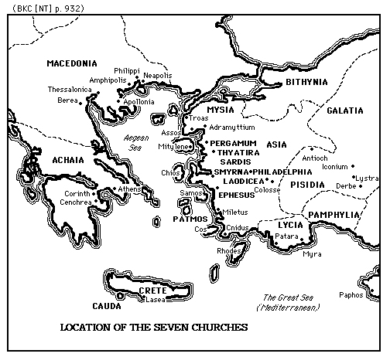
John
During his time in Ephesus he developed a sort of regional ministry and had an influence over the churches in the area. We derive this from his mention of the “seven churches of Asia” in the Book of Revelation and his apparent unique relationship to them.

Slide 51
John
  He was exiled to the Isle of Patmos due to the ruling of the Roman Emperor Domitian – and was later released and allowed to return to Ephesus
  He lived until the time of the Roman Emperor Trajan and during that time would have witnessed a significant amount of persecution against Christians.

Slide 52
John
He is considered a Pastor committed to loving the people and work of God, for church tradition has him often quoted saying; “Little children love one another” and when questioned by his disciple as to why he would so often say those words his reply was; it is the Lord’s command, and if this alone be done, it is enough!”

Slide 53
John
His ministry spanned a number of years in which he probably established several churches throughout Asia and it is estimated that he didn’t die until approximately A.D. 100. There is no evidence that he was martyred and it is believed that he died a natural death.

Slide 54
Phillip
There is very little information about him but one significant notation worth mentioning was his response to Nathanael after meeting Jesus; “We have found Him of whom Moses in the Law and also the prophets wrote – Jesus of Nazareth, the son of Joseph”. (John 1:45)
He was from Bethsaida of Galilee – just like Peter and Andrew

Slide 55
Phillip
Some confuse him with the Philip the Deacon/Evangelist (Acts 6:1-5, Acts 21:8), but these would have been two different people.
Various church traditions claim that he was involved in the Apostolic College
It is believed that he ministered in the region of Galatia (in Turkey) and tradition has him being martyred at the age of 87.

Slide 56
Bartholomew
His is also known as Nathanael and there is a Syrian tradition that claims his original name was Jesus but he changed it for obvious reasons.
It was Nathanael who said this to Jesus; “Rabbi, You are the Son of God, You are the King of Israel” (John 1:49)
Jesus (after His resurrection) appeared to Bartholomew along with several other disciples at the Sea of Tiberias, also known as the Sea of Galilee. (John 21:2)

Slide 57
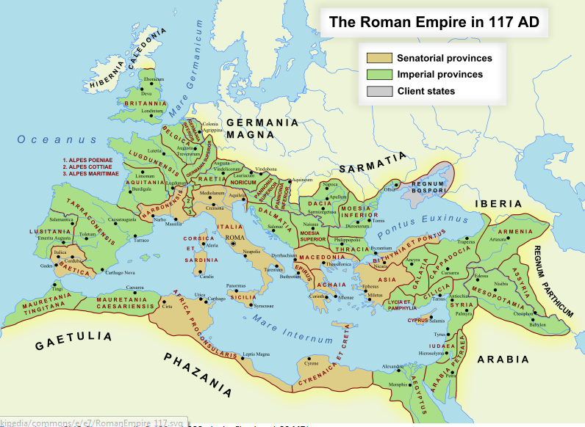
Bartholomew
The ministry of Bartholomew spanned a pretty large geographical area:
Armenia is the primary area where Bartholomew ministered.

Slide 58
Bartholomew
Here are a few of the recorded events from various church traditions that are written about Bartholomew:
  Church tradition has him first ministering in Hierapolis (located near Laodicea and Colosse – in modern day Turkey) along with the apostle Philip.

Slide 59
Bartholomew
Here are a few of the recorded events from various church traditions that are written about Bartholomew:
  The historical record along with church tradition shows that while in Hierapolis; Bartholomew and Philip were responsible for the wife of a high Roman official (proconsul) coming to faith in Christ. This apparently enraged the Roman official and he ordered the two men (Philip and Bartholomew) to be crucified, but Bartholomew escaped after being taken down from the cross and subsequently dismissed for some reason.

Slide 60
Bartholomew
Here are a few of the recorded events from various church traditions that are written about Bartholomew:
  From Hierapolis Bartholomew traveled to the East and visited India and then eventually settled in the region of Armenia. According to their tradition, he joined up with the apostle Jude (Thaddaeus) who already had a ministry there.

Slide 61
Bartholomew
Here are a few of the recorded events from various church traditions that are written about Bartholomew:
  Tradition also claims that on his missionary journey’s that he carried the Gospel of Matthew with him and it is believed that he left a copy behind in India. The book eventually ended up in the hands of a stoic philosopher by the name of Pantaenus who had previously became converted to Christianity. Pantaenus was responsible for founding the Catechetical School of Alexandria (in Egypt) and was a mentor to a very influential thinker, apologist and writer by the name of Clement of Alexandria (more on him later).

Slide 62
Bartholomew
Here are a few of the recorded events from various church traditions that are written about Bartholomew:
  The primary ministry of Bartholomew took place in the area of Armenia and he labored there until his death. There is wide agreement that he was martyred while ministering in Armenia. Some traditions claim he was beheaded while others claim he was skinned alive and then crucified. The date of his death is commonly placed in A.D. 68 and the location is modern day Azerbaijan.

Slide 63
Thomas
He is also known as Didymus (the twin); he was a fisherman by trade, and a native of Galilee.
Here are a few traditions about this apostle:
  He traveled to Babylon (modern day Iraq) and established the first Christian Church there.
  From there it is believed that he evangelized in the region of India and may have traveled as far as China.
  While in India it is believed he was martyred and was killed with a lance. He was buried in Mylapore, India.

Slide 64
Matthew
He is also called Levi (perhaps he was the first to promote wearing blue jeans), and he was the son of Alphaeus which would make him the brother of James the Less. (Son of Alphaeus).
He was a tax collector before being called By Jesus to come and follow Him.
After the resurrection it is believed that he initially stayed in the region of Jerusalem, and after about 15 years, he began a series of missionary journeys.

Slide 65
Matthew
He went to Persia and ministered there for a season, and Catholic tradition has him traveling to Ethiopia in Africa and eventually being martyred in Egypt. There is another tradition that has him being martyred in Parthia.
We have Matthew to thank for a well penned Gospel account of the life of Christ. He was known as a gifted writer, a dedicated disciple, and probably the best educated of the original 12 disciples.

Slide 66
James (Son of Alphaeus)
He is sometimes referred to as James the Less
There are two basic traditions that about this James:
  He helped to establish the Syrian Church and was their first bishop
  He was stoned to death in Jerusalem for preaching Christ
This is also not the same James who wrote the Epistle of James

Slide 67
Jude (Thaddaeus)
Jude was one of the first apostles to leave Jerusalem and head to a foreign country. Tradition claims he was the first to witness directly to a foreign (Gentile) king.
Most traditions have him ministering in the region of Armenia (some of his time being spent with Bartholomew and possibly some with Thomas), specifically in the city of Edessa.
Some traditions also place him in Syria and Northern Persia where it is believed he was martyred.

Slide 68
Simon the Zealot
Tradition has him ministering primarily in the region of North Africa and possibly even into Britain.
There are two basic traditions about his death:
  One version is that he was crucified in Britain by the Romans in A.D. 61
  Another version claims that sometime after leaving Britain he traveled to Persia and was martyred there by being sawed in two.

Slide 69
The Other Apostles
Matthias
  He was the replacement for Judas Iscariot
  Tradition places him in the region of Armenia and may have been assisted by the apostle Andrew.
  Most all traditions agree that he was martyred but the location of his death by martyrdom is unclear.
Paul (more on him in our next lesson)

Slide 70
Concluding Thoughts:
We have no concluding Biblical evidence of a “perpetual” continuation of the office of Apostle (as some teach) and therefore within our basic system of belief it (The office of Apostle) ceased upon their subsequent deaths.

Slide 71
Concluding Thoughts:
The influence of each of these men within Jerusalem, Judea, Samaria and the uttermost parts of the earth goes beyond what we are capable of absorbing in our finite minds. If the subject matter interests you there is a host of writings that record a plethora of information. The reliability of that data may be difficult to verify as it eventually becomes skewed toward a particular theological or philosophical bent as the church begins to expand in the later centuries. This is what will later lead to “denominations” and various “orthodox” positions (i.e. Eastern Orthodox, Greek Orthodox, Coptic Christianity, Russian Orthodox etc.) that are too numerous to list.

Slide 72
Concluding Thoughts:
We should applaud the early work of these Apostles for without them and their missionary efforts, we would be headed for an eternity without Christ.
In our next lesson we will explore an overview of the ministry of Paul, and then from there we will study several other key leaders who carry the torch in spreading the gospel after the apostles died…..stay tuned!

