Slide 1
Heroes of Faith
New Testament Period
Faith in Action – Part II
Paul the Apostle

Slide 2
Paul’s Early Life:
He was an Israelite from the tribe of Benjamin (Romans 11:1, Philippians 3:5)
He was a Pharisee who was trained under Gamaliel (Philippians 3:5, Acts 22:3)
He was a zealous persecutor of Christians
He was a Roman citizen (Acts 22:25-29)

Slide 3
His New Life:
Everything changed for Paul when he met Christ on the Road to Damascus and submitted to Him. (Acts 9:4-31, Acts 22:1-16)
In a later letter to Timothy, Paul recognized himself to be “chief among sinners”, yet one who found God’s mercy and grace through faith in Jesus Christ.

Slide 4
His New Life:
“I thank Christ Jesus our Lord, who has strengthened me, because He considered me faithful, putting me into service, even though formerly I was a blasphemer and a persecutor and a violent aggressor. Yet I was shown mercy because I acted ignorantly in unbelief; and the grace of our Lord was more abundant, with the faith and love which are found in Christ Jesus. It is a trustworthy statement, deserving full acceptance, that Christ Jesus came into the world to save sinners, among whom I am foremost of all. Yet for this reason, I found mercy, so that in me as the foremost, Jesus Christ might demonstrate His perfect patience as an example for those who would believe in Him for eternal life” (I Timothy 1:12-16)

Slide 5
Paul’s Early Years in Ministry:
After spending about 3 years (37-40 AD) in Damascus (Gal. 1:17-18, Acts 9:22-23) he will meet up with Barnabas, Peter, and James in Jerusalem.
Some of the disciples are skeptical at first, but Barnabas will persuade the believers that Paul is now one of them. (Acts 9:26-31, Galatians 1:18-19)

Slide 6
Paul’s Early Years in Ministry:
Paul and Barnabas will travel to Antioch in Syria and remain there for about 1 year. (Acts 11:26-28)
  It is here that the disciples were first called Christians
  The church was growing rapidly and numerically which was good but it also caught the eye of the Jewish religious leaders.
  It was during this period (41-44 AD) that James (brother of the Apostle John) was martyred by Herod Agrippa I (Acts 12:2)

Slide 7
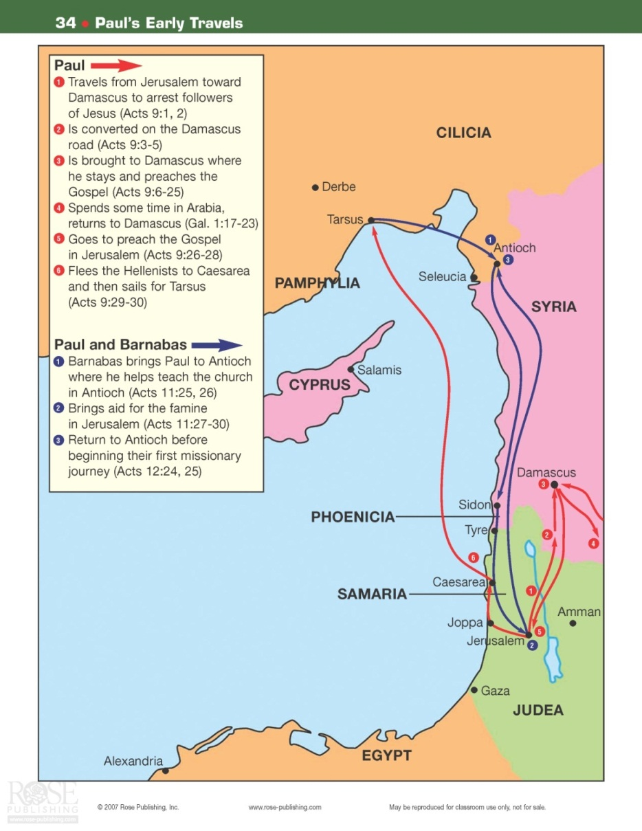
Paul’s Early Years in Ministry:

Slide 8
Paul’s Main Ministry Years
First Missionary Journey (A.D. 45-47)
Second Missionary Journey (A.D. 51-53)
Third Missionary Journey (A.D. 54-58)

Slide 9
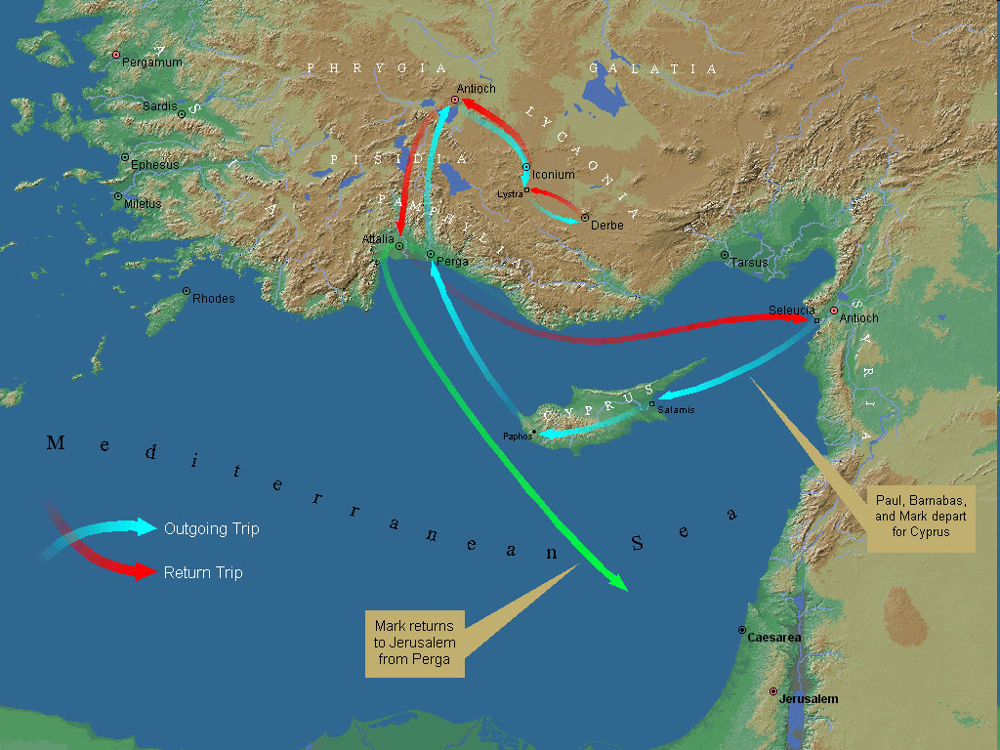
Paul’s First Missionary Journey (45-47)

Slide 10
Paul’s First Missionary Journey (45-47)
Paul, Barnabas, & Mark leave Antioch (Acts 13:4) and sail to Cyprus (an island about 100 miles off the coast of Syria)
While on Cyprus they will travel from Salamis to Paphos where Paul will meet up with a Jewish sorcerer named Bar Jesus. (Acts 13:4-6)

Slide 11
Paul’s First Missionary Journey (45-47)
Three very significant things will transpire while Paul, Barnabas and Mark are on the island of Cyprus
  Many Gentiles will come to faith in Christ including one known as Sergius Paulus
  The rejection by the Jewish religious leaders and the clear division between them and the Christians will begin to really take shape.
  Paul’s leadership role will begin to take shape

Slide 12
Paul’s First Missionary Journey (45-47)
They (Paul, John-Mark, Barnabas) will leave Paphos and sail to Perga in Pamphylia (Present day southern Turkey)
Upon arriving in Perga Mark will depart back to Jerusalem

Slide 13
Paul’s First Missionary Journey (45-47)
The ministry of Paul and Barnabas will begin to turn toward the Gentiles while at Antioch in Pisidia (Acts 13:46)

Slide 14
Paul’s First Missionary Journey (45-47)
They will travel through the cities of Iconium, Lystra (where Paul will be stoned with rocks – thought to be dead but lives; Acts 14:19), then to Derbe, and back to Lystra, Iconium, and to Antioch in Pisidia.

Slide 15
Paul’s First Missionary Journey (45-47)
They will finally return to their sending church in Antioch in Syria (Acts 14:24-26)

Slide 16
Between the 1st and 2nd Missionary Journeys
Most commentators and scholars believe that Paul wrote the book of Galatians while in Antioch (A.D. 48), just prior to attending the Christian Council in Jerusalem.
Paul and Barnabas will meet with the Christian Council in Jerusalem (Acts 15:2, Galatians 2:1-9)
Judas and Silas will connect with Paul and Barnabas in Antioch (Syria) (Acts 15:35-36). The purpose of their meeting was to deliver a letter to the Gentile believers outlining how the Gentiles should conduct themselves by ceasing to live as pagans.

Slide 17
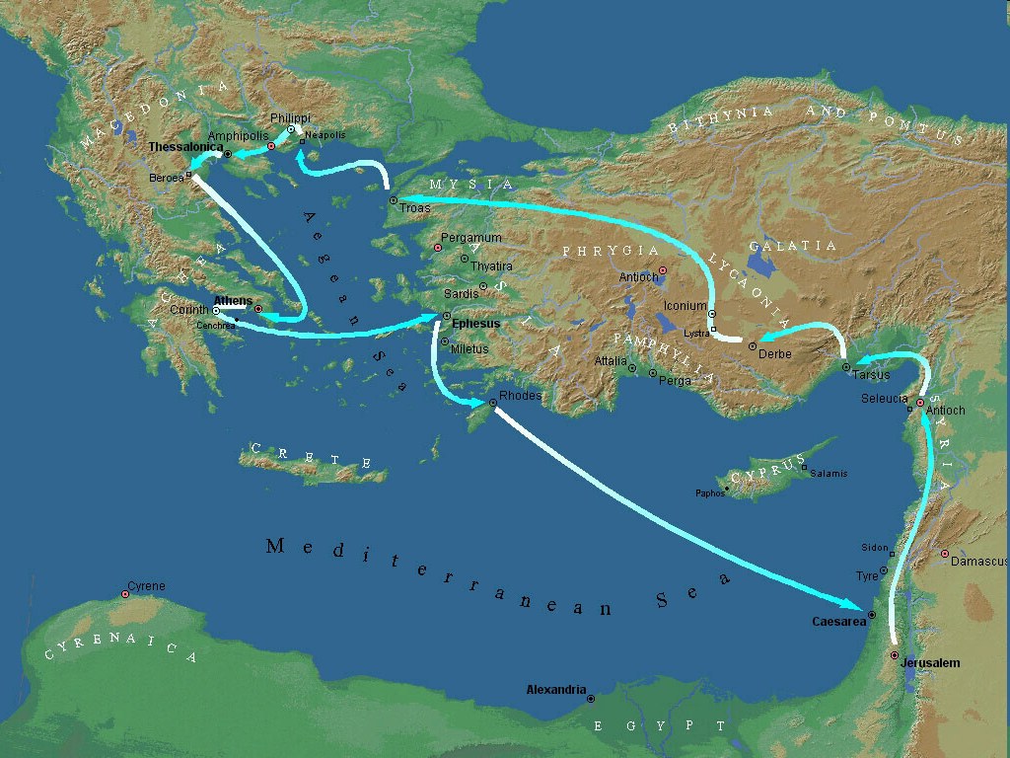
Paul’s Second Missionary Journey (51-53)

Slide 18
Paul’s Second Missionary Journey (51-53)
This second journey probably begins in the spring of 51 AD with Paul and Silas traveling through Syria & Cilicia (Modern day southeastern Turkey)
They (Paul & Silas) will meet up with Timothy and travel through the region of Phrygia and Galatia (Central Turkey)

Slide 19
Paul’s Second Missionary Journey (51-53)
Paul wanted to travel into Asia but he didn’t receive such direction from the Holy Spirit (Acts 16:6)
Instead of going to Asia they will travel to Troas, then to Neapolis. They will receive a vision that encourages them to take the Gospel to Macedonia. (Acts 16:9-11)

Slide 20
Paul’s Second Missionary Journey (51-53)
It is because of this obedience to go to Macedonia that Paul will minister to two very important individuals while in the town of Philippi (Acts 16:14-34)
  Lydia
  Philippian Jailer

Slide 21
Paul’s Second Missionary Journey (51-53)
After leaving Philippi Paul will travel to Thessalonica after passing through Amphipolis and Appolonia.
  He will teach for about 3 weeks while in Thessalonica
  He will also do some teaching in the region of Berea

Slide 22
Paul’s Second Missionary Journey (51-53)
Paul leaves (ahead of Timothy & Silas) and travels toward Achaia (southern Greece) and then to Athens where he will spend the winter; 51-52 (Acts 17:14-15)

Slide 23
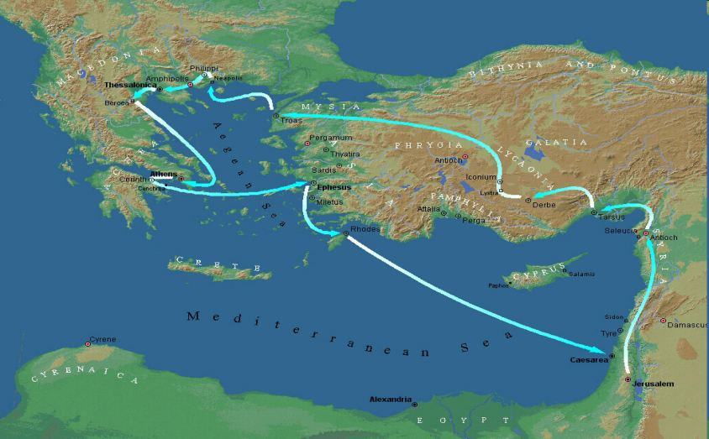
Paul’s Second Missionary Journey (51-53)
Paul will then visit Corinth for the first time and will remain there for about a year and a half (Acts 18:5). From the spring of 52 AD to the fall of 53 AD.
  While there; he will meet up with Aquila and Priscilla who came there from Rome because of the persecution of the Jews by Claudius Caesar.
  Silas and Timothy will rejoin Paul at this time

Slide 24
Paul’s Second Missionary Journey (51-53)
While in Corinth Paul accomplishes the following:
  He will write his first letter to the Thessalonians in about 52 AD. (I Thessalonians 3:1-2, 6)
  He will also write II Thessalonians
  Paul will experience a number of challenges due to the influence of the pagan culture of Corinth. This will require continued teaching on spiritual matters and much patience.

Slide 25
Paul’s Second Missionary Journey (51-53)
The Second journey ends with Paul, Aquila & Priscilla leaving by boat across the Aegean Sea and sailing to Ephesus, meeting up with Apollos (Acts 18:19, 26), and sailing to Caesarea and finally on to Antioch in Syria where he will spend the winter of 53-54 AD. (Acts 18:23)

Slide 26
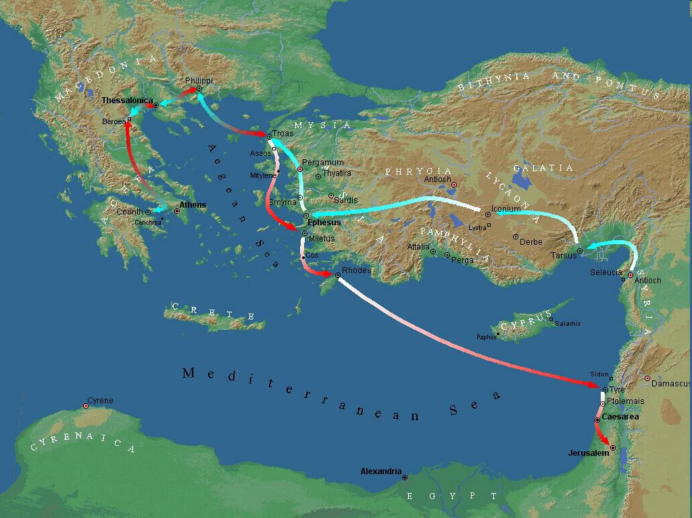
Paul’s Third Missionary Journey (54-58)

Slide 27
Paul’s Third Missionary Journey (54-58)
The journey begins from Galatia (Central Turkey) in the spring of 54 and then on to Phrygia (Acts 18:23)

Slide 28
Paul’s Third Missionary Journey (54-58)
The next major stop will be Ephesus where he will stay for about 3 years (Fall of 54 AD to the fall of 57)

Slide 29
Paul’s Third Missionary Journey (54-58)
The next major stop will be Ephesus…….
  He will meet up with some of the disciples of John the Baptist where he will lay hands on them to receive the Holy Spirit. (Acts 19:1-7)
  He will preach in the Jewish Synagogue with great boldness and did so without too much problem for about 3 months
  Eventually he meets too much opposition from the Jewish leaders and Paul will then leave the Synagogue (along with the other believers) to teach in the School of Tyrannus where he will debate with other Greek teachers, philosophers and students on a daily basis

Slide 30
Paul’s Third Missionary Journey (54-58)
Other notable events in Ephesus:
  The Scriptures tell us that; “all who lived in Asia heard the Word of the Lord, both Jew and Greek” (Acts 19:10)
  It is believed that he wrote the first letter to the Corinthians toward the end of his stay in Ephesus – probably 57 AD (I Corinthians 16:8, 19)
  Paul’s work while in Asia was so effective that on the west coast of what we know of as modern day Turkey; the churches at Colosse, Laodicea, and Hierapolis were founded. (Colossians 4:13)

Slide 31
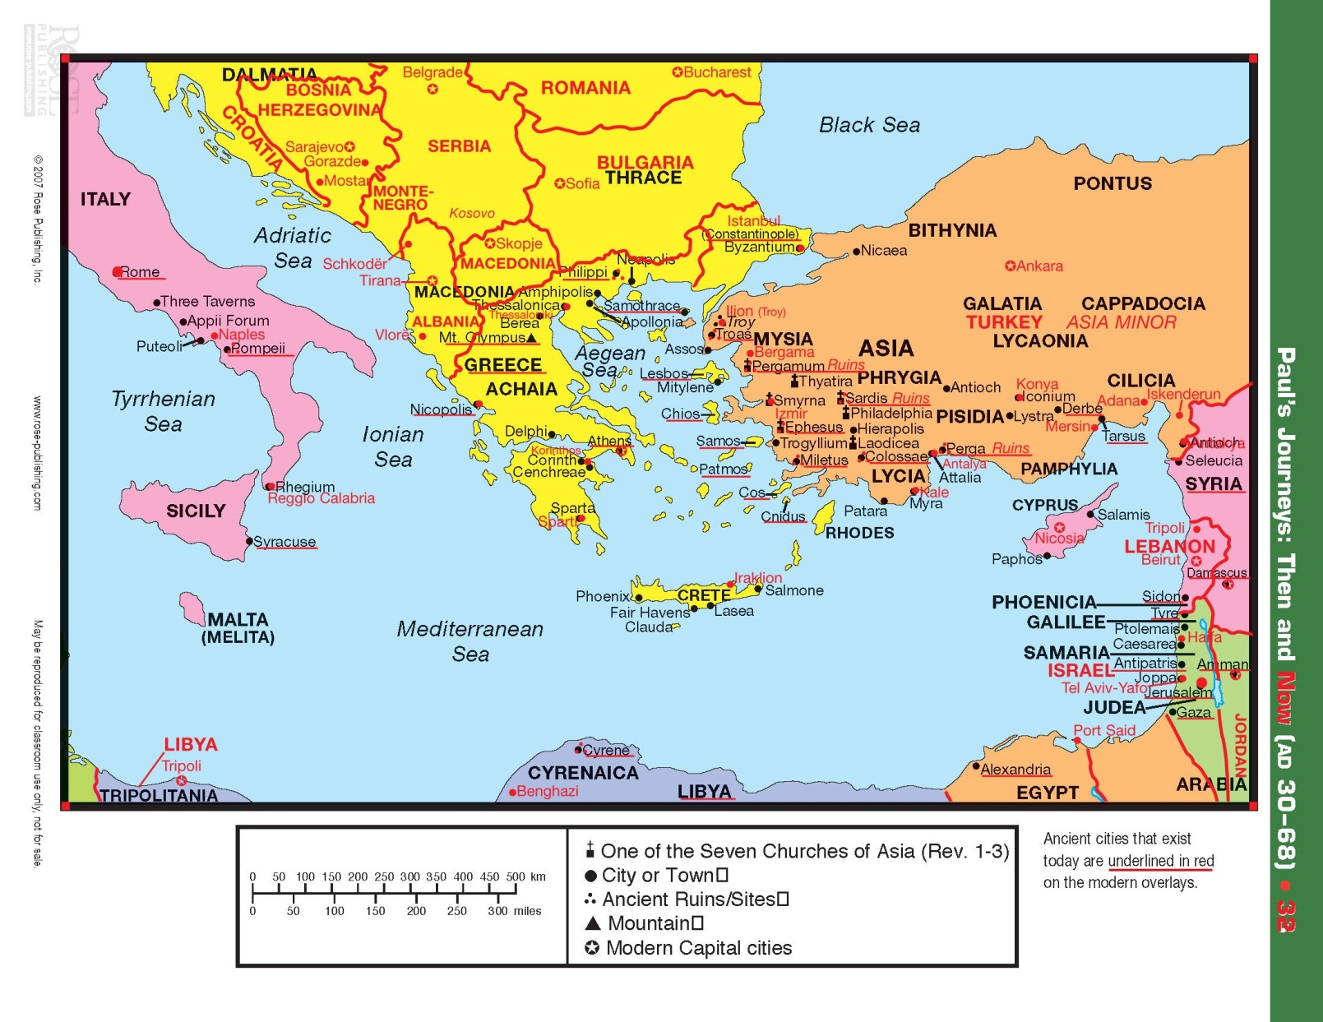
Paul’s Third Missionary Journey (54-58)

Slide 32

Paul’s Third Missionary Journey (54-58)
After some significant disturbances, riots, and other miscellaneous trouble in the region of Asia Minor; Paul sets out for Macedonia with a strong desire to visit Rome and even Spain after first returning to Jerusalem. (Romans 1:15, Romans 15:22-24)
Paul’s reason for wanting to go to Macedonia and Achaia was to affirm them in their faith and to take an offering for the saints in Jerusalem. This offering was to provide aid in helping the poor.

Slide 33

Paul’s Third Missionary Journey (54-58)
On his way to Macedonia Paul will stop in Troas (II Cor. 2:12-13, 7:5-7) for some evangelistic opportunities and to meet up with Titus to receive a report on how things were going in Corinth.
It is believed that he wrote his second letter to the Corinthians somewhere in northern Greece (most likely Philippi) in the fall of 57 AD.

Slide 34

Paul’s Third Missionary Journey (54-58)
After going to Macedonia (northern Greece) Paul will go to Achaia (southern Greece) where he will stay for about three months and make his third visit to Corinth. (The Lord knows they needed it!!!)
  Paul will spend the winter there (A.D. 57-58) and write his letter to the Romans. (I Corinthians 16:1-3, Romans 15:22-26)
  He will continue on his journey through Macedonia (Acts 20:1) and then on to Philippi in the spring of 58 AD (Acts 20:6), and then back to Troas.

Slide 35
Paul’s Third Missionary Journey (54-58)
The next significant visit is to Miletus (southwestern Turkey) where he will summon the Ephesian Elders and address them on the pending dangers that await the church at large. (Acts 20:17-38)

Slide 36
Paul’s Third Missionary Journey (54-58)
He will then travel to Coos, Rhodes, Patara and on to Tyre (modern day Lebanon) and remain there one week, and then Ptolemais and Caesarea where he stays many days. (Acts 21:10)

Slide 37
Paul’s Return to Jerusalem
His primary purpose in going to Jerusalem was to deliver the offering to the Jerusalem church that he had collected from the Gentiles during his third missionary journey. (Acts 24:17, Rom. 15:25-27, Ephesians 2:11-22, 3:6)
Paul’s friends feared that if he returned to Jerusalem that his life would be in danger, however Paul believed the Holy Spirit was leading him to go (Acts 21:4)

Slide 38
Paul’s Return to Jerusalem
While in Jerusalem Paul met up with a group of Jews who were complaining that he was teaching the Gentiles to forsake the Mosaic Law. (Acts 21:27-40)
  Paul defended himself against these unfounded accusations. (Acts 22)
  It was during this defense that Paul was seized, and when he was about to be scourged/whipped, he challenged whether he being a Roman citizen could be scourged by the Centurion? Paul’s life was spared for a season as the Lord had more for him to do! (Acts 22:24-29)

Slide 39
Paul’s Return to Jerusalem
Paul appears before the Jewish council (The Sanhedrin) where he is accused of preaching about the resurrection. (Acts 23:1-11)
A group of people committed themselves to a plot to kill the apostle Paul, so they moved Paul to Caesarea for his safety. (Acts 23:12-23)
Paul appears before the Governor of the province whose name was Felix (Acts 24)
About two years later Paul will appear before Festus (Acts 25:1-12), and while defending himself before Festus - Paul will appeal to Caesar.

Slide 40
Paul’s Return to Jerusalem
Next Paul defends himself before King Agrippa (great grandson to Herod the Great)
  Paul will give a powerful testimony of his life and how it changed the day he met Christ on the Damascus Road (Acts 26)
  It will be Agrippa who says to Paul; “You almost persuade me to be a Christian” Acts 26:28 (NKJV)
Paul will placed under the control of a Centurion named Julius and will travel by ship to Rome to have his case heard by Caesar.

Slide 41
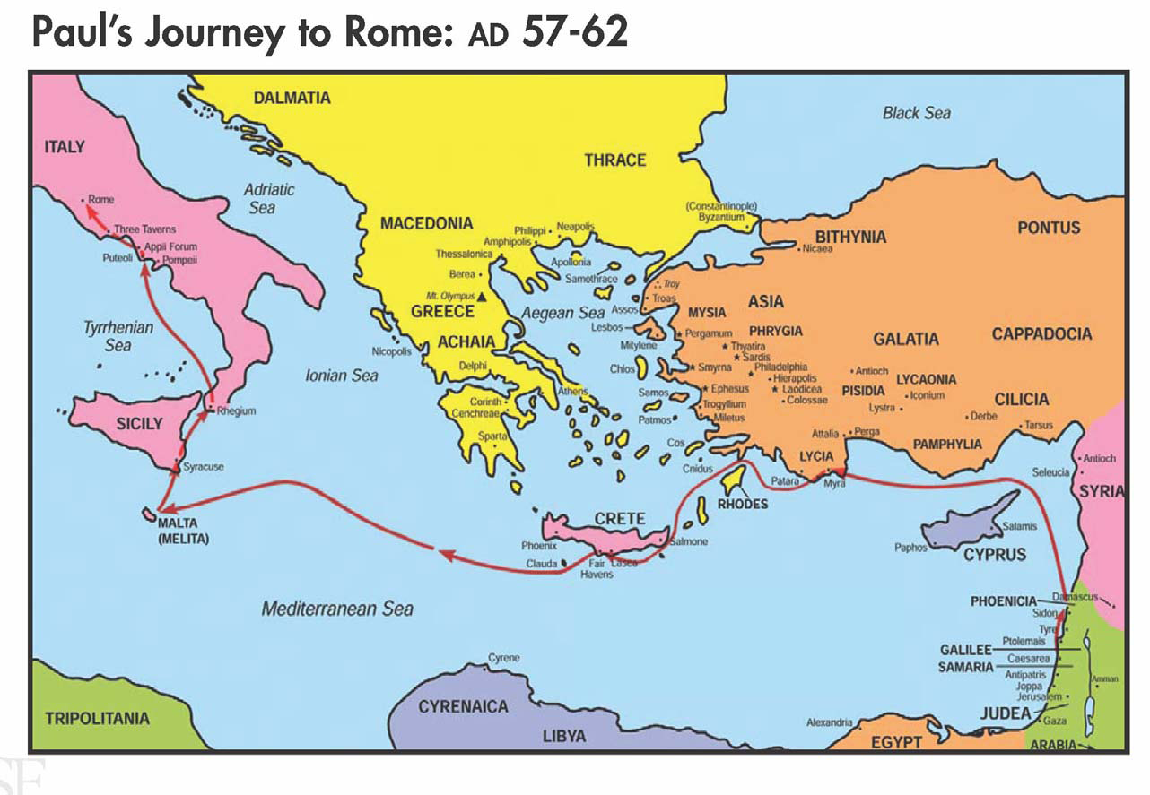
Paul’s Voyage To Rome

Slide 42
Paul’s Years in Rome
Paul will initially spend 2 years under house arrest while in Rome. (61-63 AD)
While under house arrest he will write what are commonly called the prison Epistles:
  Ephesians
  Philippians
  Colossians
  Philemon

Slide 43
Paul’s Years in Rome
Paul’s post imprisonment years (after his release from house arrest):
  He will travel some more and write his Epistle (Letter) to Titus and two letters to Timothy.
  Some conclude that he wrote Hebrews during this time but there just is not enough evidence to support this claim
  Although Acts does not record these travels we can piece together some of the places that Paul visits (Colosse, Corinth, Troas, Crete, Ephesus etc.) by reading the various letters that Paul wrote.

Slide 44
Paul’s Years in Rome
At some point he is returned to prison (although we are not given the reason) to face what would be his eventual death. (II Timothy 4:6-8)
  In spite of this impending death sentence Paul still encouraged young Timothy to come visit him and bring some of his most cherished items. (II Timothy 4:9, 21)
  It is believed that Paul was martyred in 67 AD while in Rome by order of Emperor Nero.

Slide 45
Concluding Remarks
We should be very thankful for Paul as he wrote a great deal of our New Testament – 13 books in all.
Paul was responsible for mentoring thousands of believers that blazed a trail of faith that still continues today!
What legacy of faith are you leaving?

