Slide 1
The Conflict in the Middle East
Will it lead to Peace?
Will it lead to WWIII?
Will it lead to Armageddon?

Slide 2
Introduction
Why is such a study such as this necessary?
  Because sin exists!
  Because evil is real!
  Because Satan cannot defeat God – but he is bent on destroying His creation!

Slide 3
Introduction
This is a study of people called:
  “ites” (i.e. Canaanites, Israelites, etc.)
  “ines” (i.e. Philistines etc.)
  “ians” (i.e. Palestinians, Iranians etc.)
  “ans” (i.e. Americans, etc.)

Slide 4
Introduction
These people groups have differing beliefs that at times cause division:
  “ism” (i.e. Judaism, Hinduism, Buddhism)
  “ist” (Islamist, Zionist, extremist)
  “ity” (i.e. Christianity)

Slide 5
Introduction
I am not here to tell you which of these groups are right so much as I am here to tell you that as long as mankind remains in rebellion against God – there will be war because sin exists.
The best way to change the course that mankind is on is for people to know who Jesus Christ is, to understand what He accomplished on the cross and to accept Him as Lord and Savior.
A person who rejects Jesus will continue to be in rebellion against God and as such will be unable to find genuine peace!

Slide 6
A History of
Israel

Slide 7
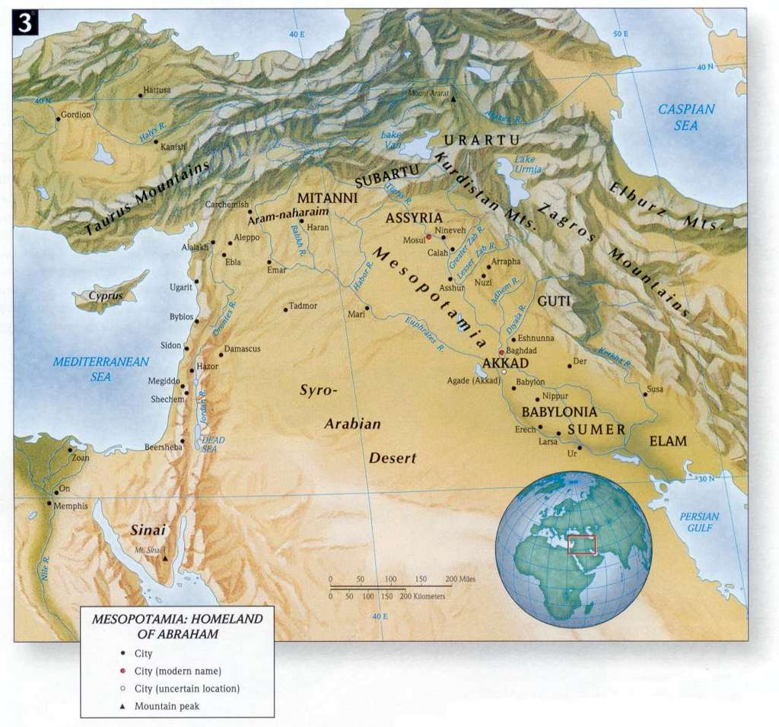
The Fertile Crescent; is where the majority of Bible events take place…it starts in Egypt, goes up through Palestine and Syria around and down through Mesopotamia.
1

Slide 8
Geography of the Bible (Overview)
The Fertile Crescent; is where the majority of Bible events takes place:
  It is called this because the land was fertile due to the accessibility to water as opposed to the desert that surrounds it, and because it is shaped like a crescent.
  This area is also called the “Cradle of Civilization” because it is where civilization began—it was all that existed of the known world to them.

Slide 9
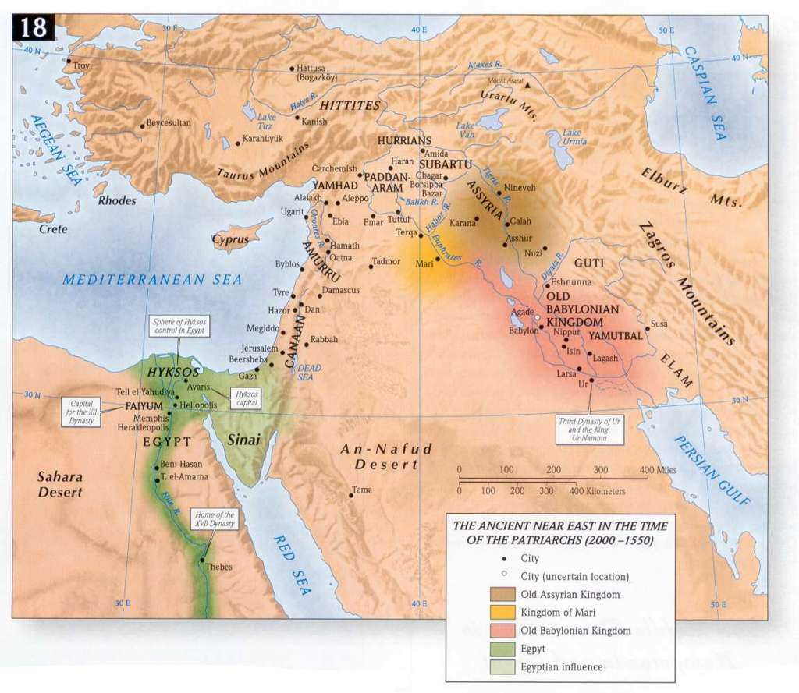
The most important natural resource in that part of the world then was water. People lived and died and even decided where they would live based on the water supply.
2

Slide 10
The “Great Sea” was the Mediterranean Sea…the other great bodies of water perhaps were unknown to them.
2

Slide 11
This seems like such a small, insignificant stretch of land…but it was the crossroads of the Ancient World (Basically is 150 miles long by 45 miles wide) and so the Land was a bridge between two great cradles of civilization Egypt and Mesopotamia)…If armies were going to get anywhere they would have had to go through this area.

Slide 12
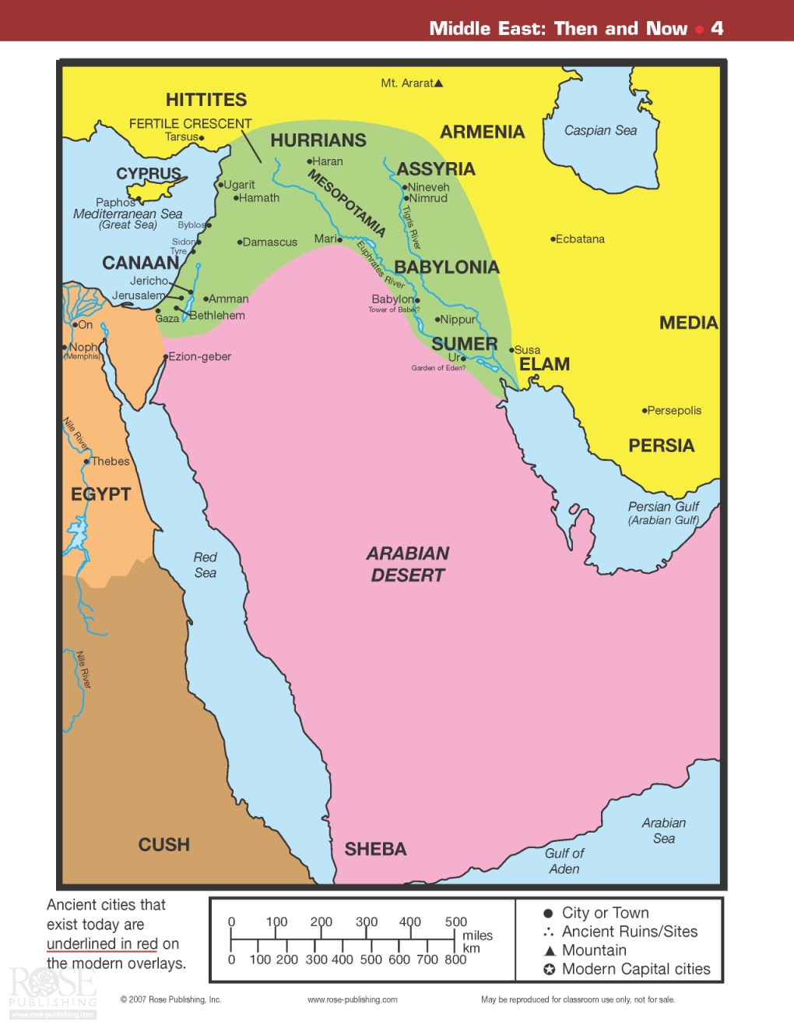
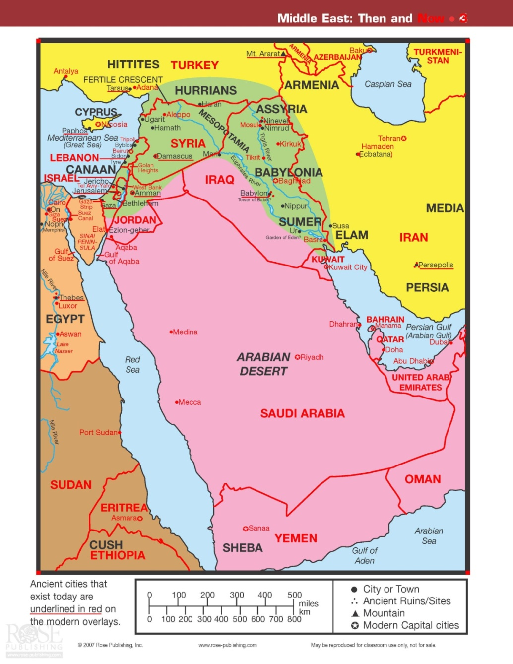
The Middle East – Then and Now

Slide 13
Palestine
Also known as Canaan
Also known as The Promised Land

Slide 14
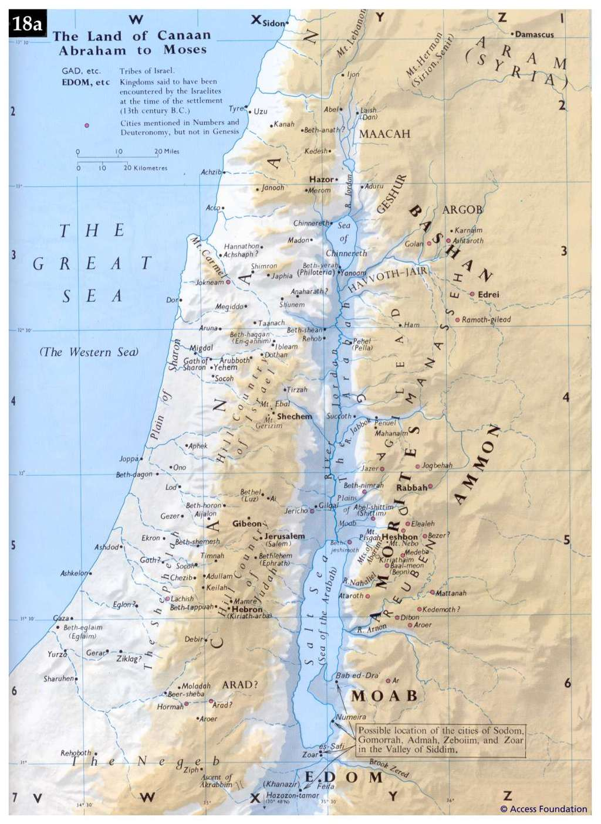
The land of Israel was once called Canaan which means the “Land of the purple”.

Slide 15
The Land of Canaan/Palestine/Israel
The first known settlers to the area of Palestine were the Phoenicians and they were famous for making purple dye…….thus the Greek word for Phoenicia is purple.
The Phoenicians were well known as “traders” or merchants and often braved the vast oceans to trade their wares on sea as well as land.

Slide 16
The Land of Canaan/Palestine/Israel
The term “Canaanite” and “merchant” became somewhat synonymous and even referenced as such in a few Biblical passages.
One of Canaan's most famous exports was a much sought-after purple dye, derived from two species of sea snails found along the east Mediterranean coast and worn proudly by figures from the ancient kings to the modern popes.

Slide 17
Pre-Abraham & Early Abraham Years
It was sometime around 2000 B.C. that God called Abraham to leave his father’s home in Ur (of the Chaldeans) and go to a new land (of promise). (Genesis 12:1-8)
He travels from Ur to Haran
From Haran to Palestine
From Palestine to Egypt
From Egypt back to Palestine

Slide 18
The Lord spoke these words to Abraham:
“And I will make you a great nation, and I will bless you, and make your name great; and so you shall be a blessing; and I will bless those who bless you, and the one who curses you I will curse. And in you all the families of the earth will be blessed” (Genesis 12:2-3)

Slide 19
“Abraham passed through the land as far as the site of Shechem, to the oak of Moreh. Now the Canaanite was in the land. The Lord appeared to Abram and said, to your descendants I will give this land. So he built an altar there to the Lord who appeared to him” (Genesis 12:7)

Slide 20
“So Lot chose for himself all the valleys of the Jordan and Lot journeyed eastward. Thus they separated from each other. Abraham settled in the land of Canaan while Lot settled in the cities of the valley and moved his tents as far as Sodom. (Gen. 13:11-12)

Slide 21
A First of Many Family Divisions
Lot fathered two sons from an incestuous relationship with his two daughters:
  Moab: whose descendants were the Moabites – they will become enemies of the Israelites
  Ammon: whose descendants were the Ammonites – they will also become enemies of the Israelites

Slide 22
The Lord’s Promise to Abraham
“I will give to you and your descendants after you, the land of your sojourning, all the land of Canaan, for an everlasting possession, and I will be their God” (Genesis 17:8)

Slide 23
Abraham’s Descendants:
Ishmael (His mother was Hagar)
Isaac (His mother was Sarai/Sarah) who was the child of promise
Zimran, Jokshan, Medan, Midian, Ishbak, Shuah (Their mother is Keturah)

Slide 24
Abraham’s Descendants:
Ishmael
  He will have many sons (at least 12) who will become princes and Ishmael and his descendants will prosper
  There was animosity between the family of Ishmael and his brother Isaac due to the favor showed to Isaac (the son of promise)
  Many conclude that Ishmael’s descendants are the Arab people

Slide 25
Abraham’s Descendants:
Zimran, Jokshan, Medan, Midian, Ishbak, Shuah
  These are 6 other sons that Abraham fathered though his concubine named Keturah
  The most prominent of the 6 was Midian whose descendants were the Midianites who would later assist Moses when he fled from Egypt
  Not all of Abrahams offspring were favorably disposed to the Israelites.

Slide 26
Abraham’s Descendants:
Isaac
  He was the son of promise and the one whom the Lord chose to receive the same blessing and promises made to Abraham.
  Isaac will father two sons (Jacob and Esau); one of which will become the father of the 12 tribes of Israel.

Slide 27
Isaac’s Descendants:
Esau
  Sold his birthright to Jacob
  His descendants became known as Edomites
  The Edomites were not favorably disposed to the Israelites (Jacobs offspring)
Jacob

Slide 28
Jacob’s Sons – 12 Tribes of Israel
Leah & Zilpah
Rachel & Bilhah
Reuben
Simeon
Levi
Judah
Gad
Asher
Issachar
Zebulun
Dan
Naphtali
Joseph
Benjamin

Slide 29
The Family Moves to Egypt
A severe famine occurred during the days of Jacob (The Lord changed his name to Israel)
  Through a series of events; one of Jacob’s sons whose name was Joseph had become a high ranking Egyptian official
  Joseph sent for his father to come to Egypt to help his family survive the famine
  Jacob and his family (70 in all) now called Hebrews settled in Egypt in the area known as Goshen.

Slide 30
Living in Egypt
Jacob and his family (also now called Israelites) enjoyed years of special position and protection while in Egypt for a season
  Eventually, a new Egyptian regime will take over, enslave the Israelites and force them to work on the Royal Building Projects
  This will lead to the Exodus from Egypt back to the Land of Promise

Slide 31
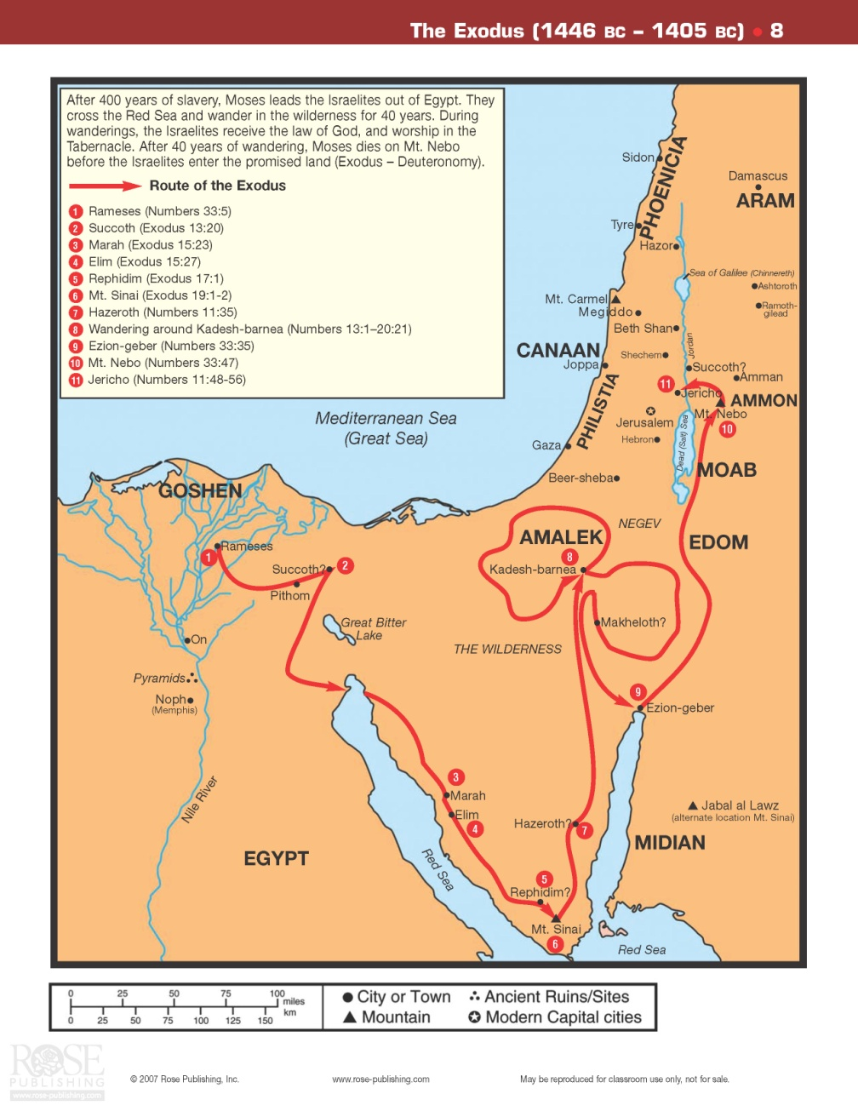
The Time of the Exodus
After the Exodus, the Israelites wander in the wilderness of Sinai for 40 years (one generation) and during this time they will receive the Covenant of the Law.

Slide 32
The Conquest of Canaan
After Moses dies; a young man named Joshua will lead the Israelites back into Canaan (The Promised land).
  The most probable date of the conquest was 1406 B.C.
  The conquest began with an attack against Jericho and it took approximately seven years to finish the occupation of Canaan

Slide 33
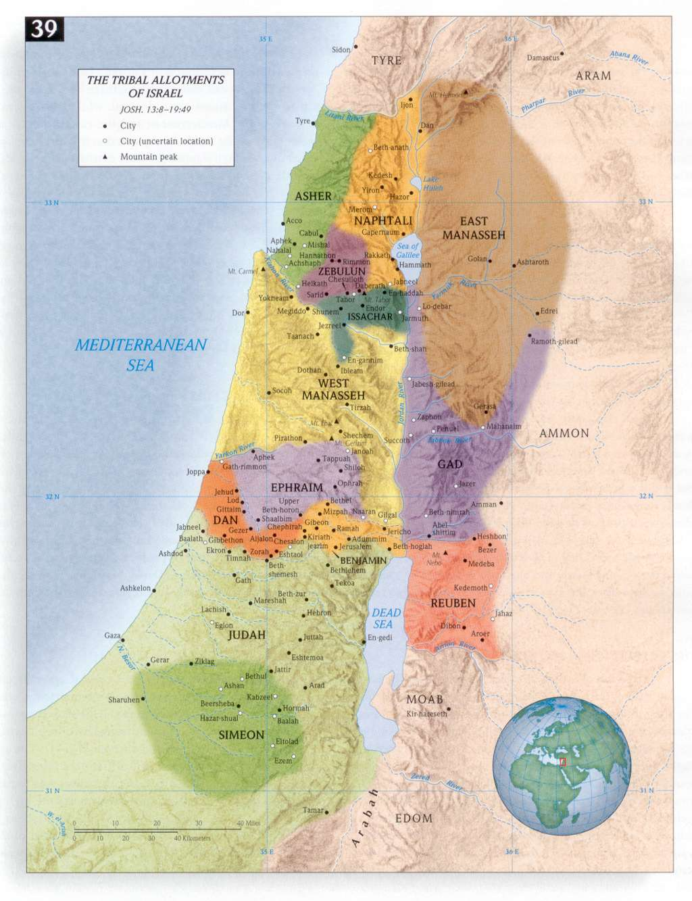
The Conquest of Canaan
The conquest began with an attack against Jericho.
At the conclusion of the conquest (as recorded in the Book of Joshua) the Promised Land was divided among the 12 tribes of Israel.

Slide 34
Between 1200 BC–1100 BC, most of southern Canaan was conquered by the Israelites.

Slide 35
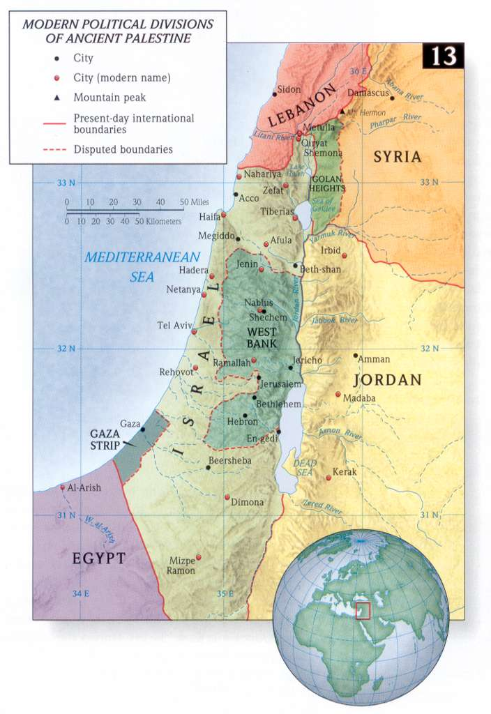
The region/land known as Israel/Palestine would include all of what is in the present day State if Israel, along with the West Bank, part of western Jordan, southern and coastal Syria, Lebanon, and continuing up to the border of modern Turkey.

Slide 36
The Period of the Judges (1350-1050)
This period of Israel’s history was known for its loose governmental structure
The Judges were not elected rulers
  They were often charismatic people whom the people tended to rally around
  The Spirit would often empower them to perform miraculous accomplishments that were of a Divine appointment or determination

Slide 37
The Period of the Judges (1350-1050)
During this time the people (Israelites) were known for doing what was right in their own eyes. Sin and disobedience became a normal way of life.
Israel at this point was still not a unified nation and more of a loose confederation of all of the tribes.

Slide 38
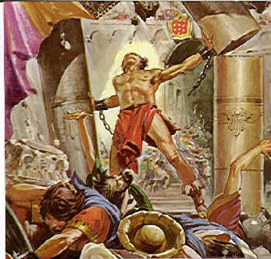
The Period of the Judges (1350-1050)
There was no major military threat during this period with the exception of the new kids on the block – the Philistines. (They became stronger as time went on and were known for using iron weapons instead of bronze like the Israelites used)

Slide 39
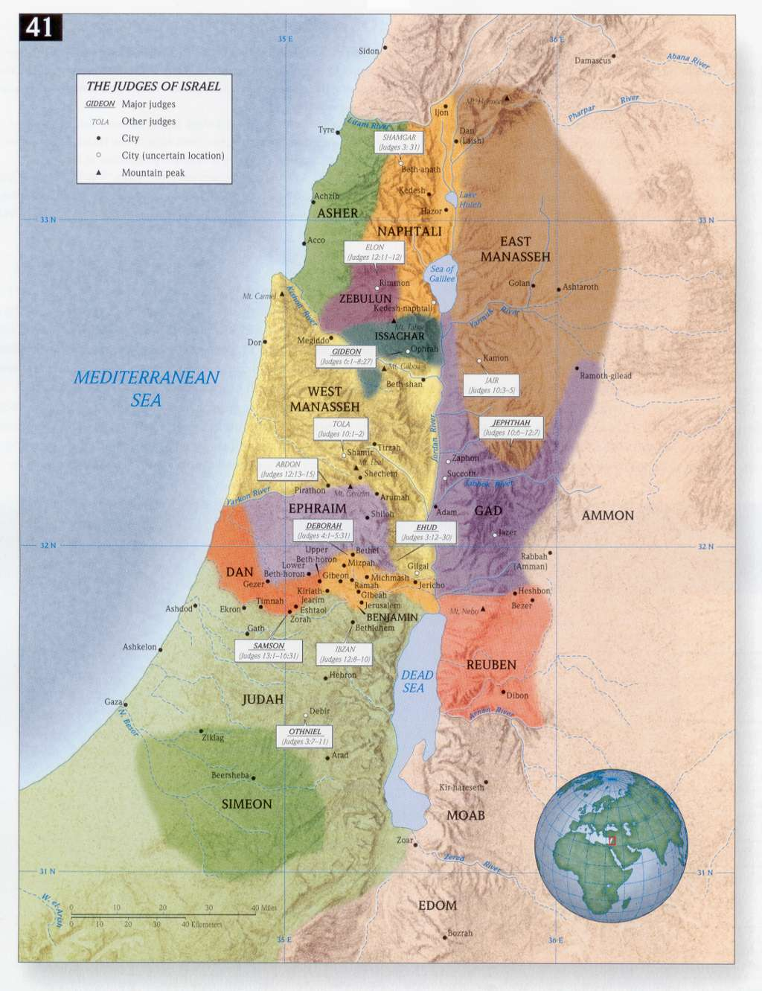
The Period of the Judges (1350-1050)
Some of the more noted Judges were:
Deborah
Barak
Gideon
Samson

Slide 40
The Period of the Kings
(1050-586 B.C)
The people of Israel began to cry for a king which was a major shift from a Theocracy (God ruled) to a Monarchy (man ruled).

Slide 41
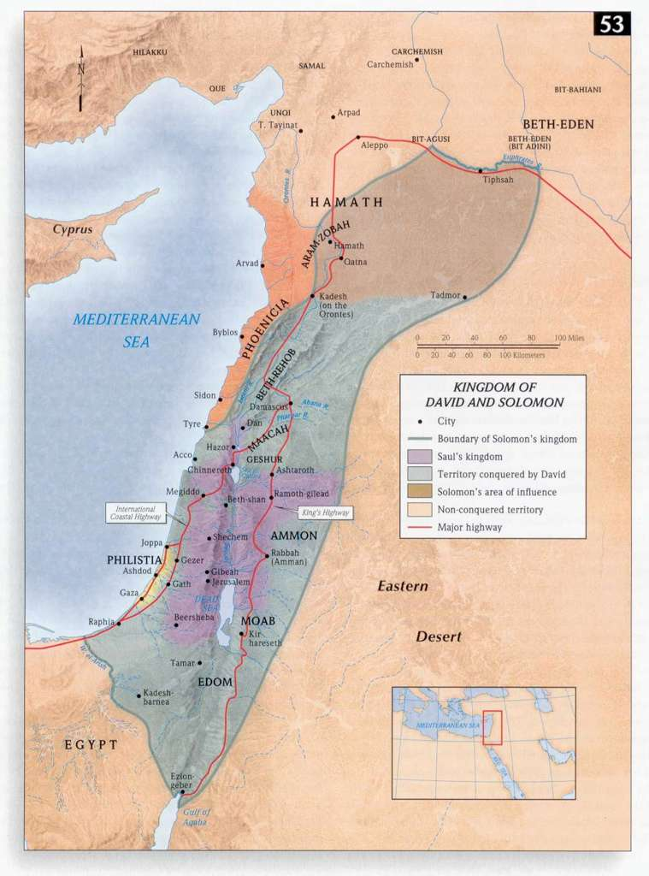
This was the Kingdom of Israel under the reign of David and Solomon. This was the largest territorial expansion the Israelites experienced.

Slide 42
The Lord said these words to King David; “Your house and your kingdom shall endure before Me forever; your throne shall be established forever” (II Samuel 7:16)
And what one nation on the earth is like your people Israel, whom God went to redeem for Himself as a people and to make a name for Himself, and to do a great thing for You and awesome things for Your land, before Your people whom You have redeemed for Yourself from Egypt, from nations and their gods? For You have established for Yourself Your people Israel as Your own people forever, and You, O Lord, have become their God” (II Samuel 7:23-24)

Slide 43
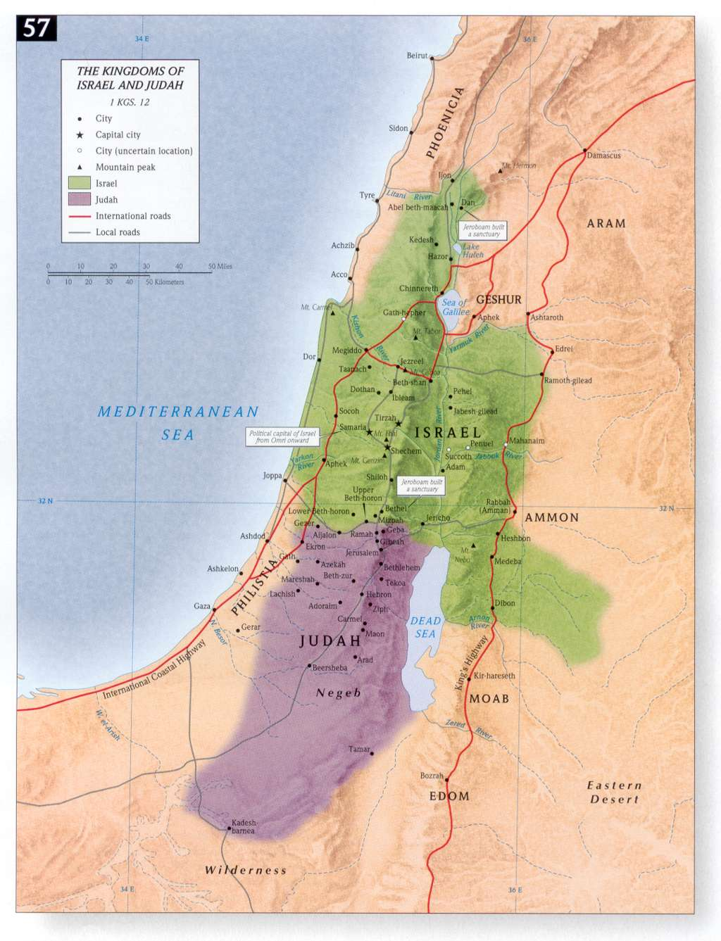
After the death of Solomon the Kingdom of Israel split into the “Northern Kingdom” of Israel and the “Southern Kingdom” of Judah

Slide 44
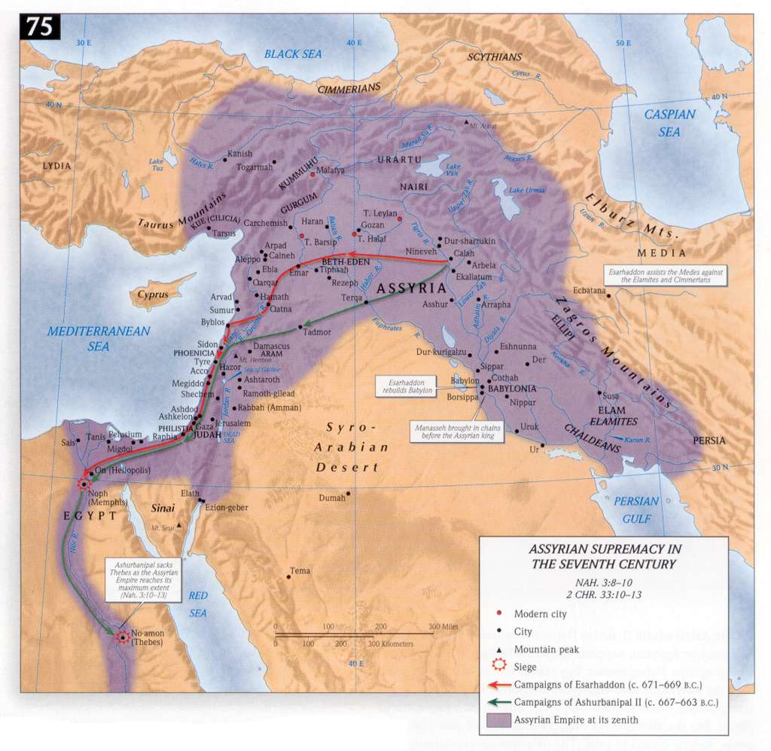
The Assyrian Empire conquered the Northern Kingdom of Israel in 722 B.C.

Slide 45
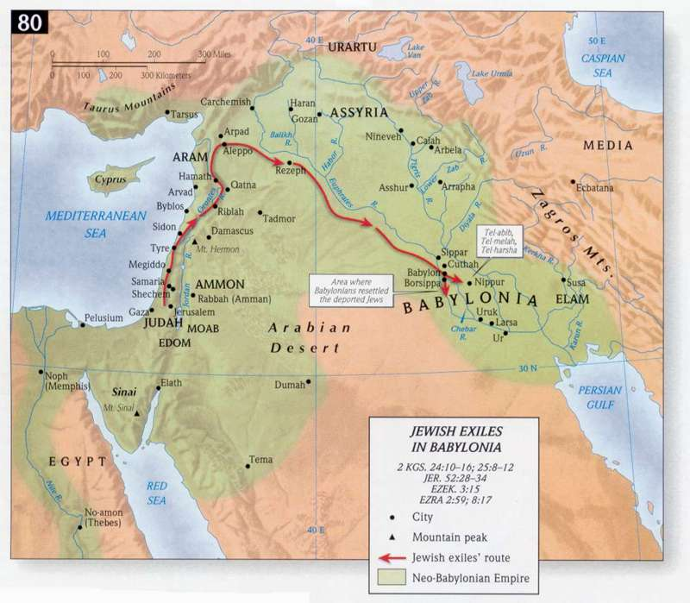
The Babylonian Empire conquered the Southern Kingdom of Israel and took them into captivity (586 B.C). The Kingdom of Israel and Judah never formally recovered as an Empire and they have been controlled by foreigners ever since.

Slide 46
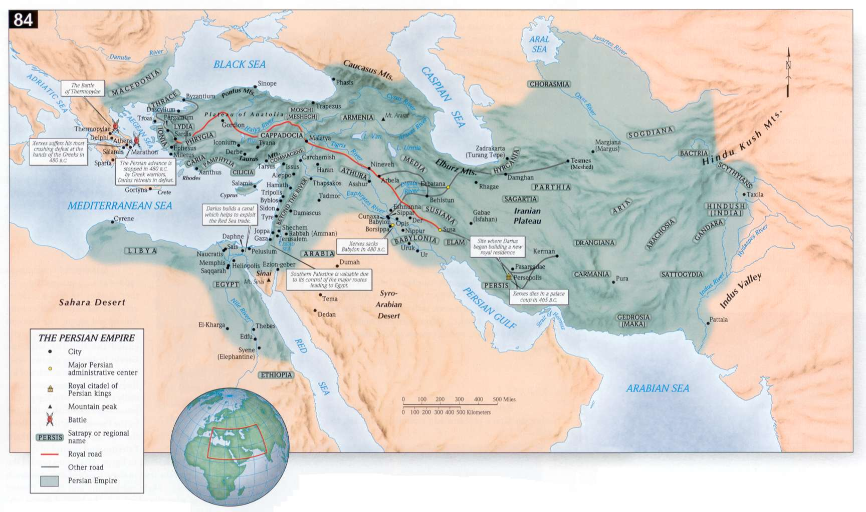
The Persian Empire conquered the Babylonians in 539 B.C. and gained control of the land of Israel.

Slide 47
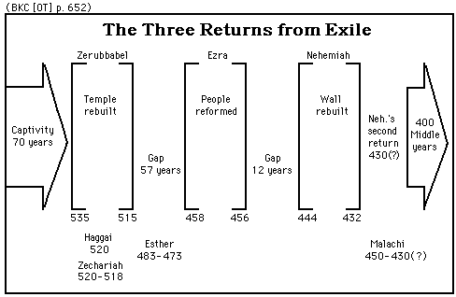
The Jews were permitted to return to Jerusalem and rebuild their temple during the Persian reign.

Slide 48
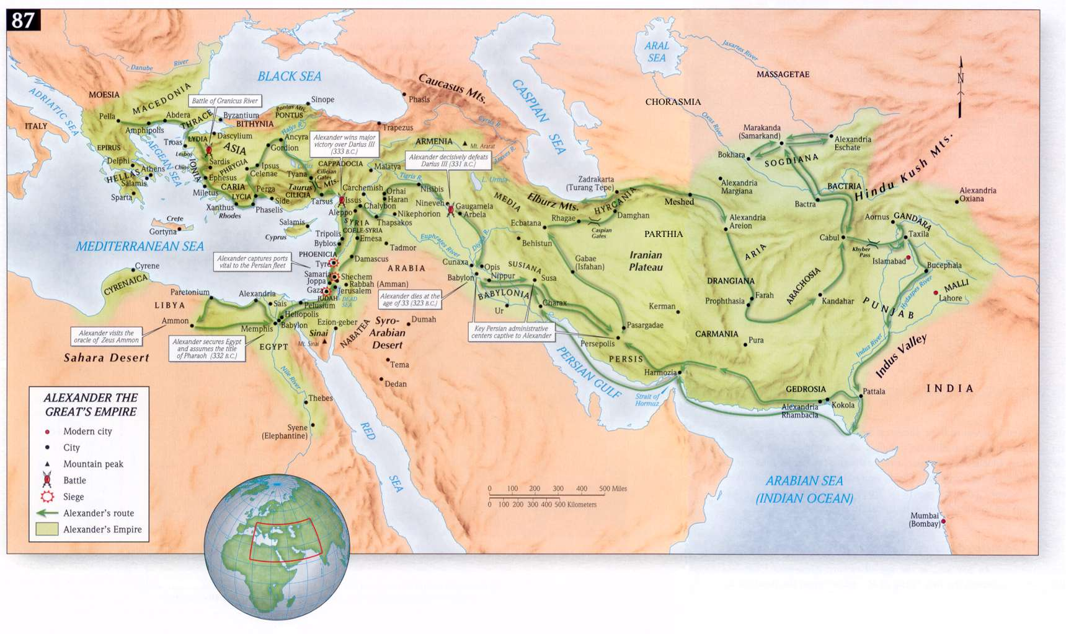
The Greeks under the reign of Alexander the Great conquered the Persians in 331 B.C. and controlled Palestine until they were defeated by the Romans.

Slide 49
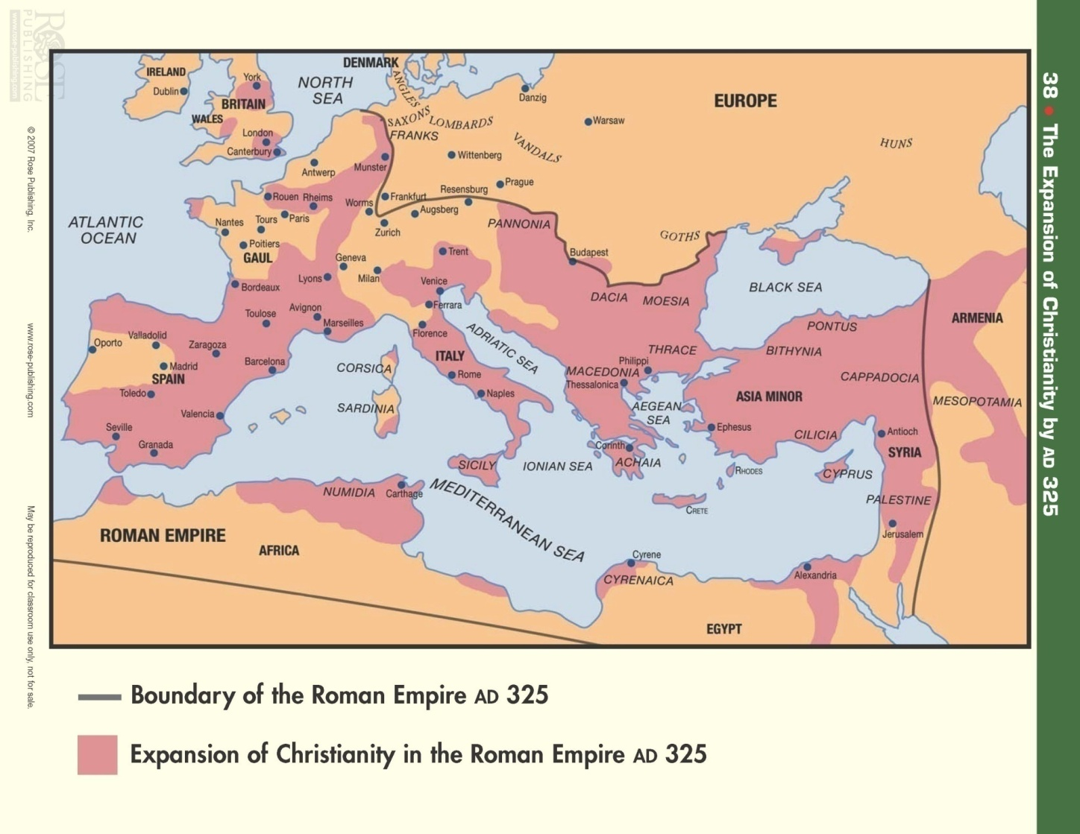
The Roman empire conquered the Greek empire by 30 B.C. and controlled Palestine through the time of Christ and the Apostles

Slide 50
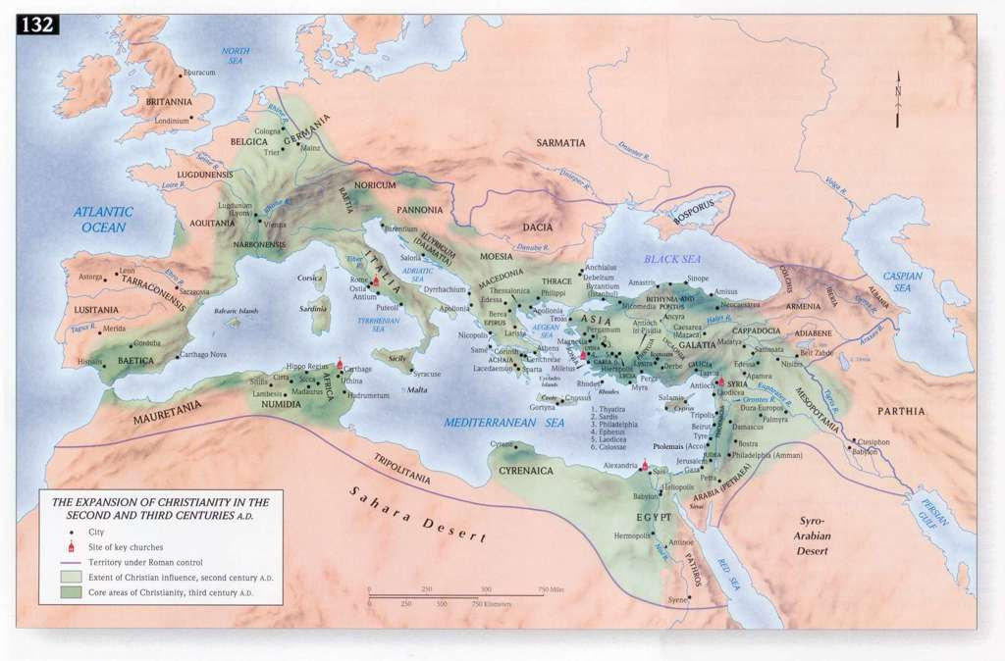

Slide 51
What about the modern dispute between the “Palestinians” and the “Israelis” over the regions referred to as the “Gaza Strip”, “West Bank” and “Golan Heights” or even the main body of land called the State of Israel?
Who does the land belong to?

Slide 52
The Land of Biblical Israel or Palestine/Holy Land
After the Roman Empire broke apart, the “Holy Land” fell under control of various groups and factions.
The Arab Muslims controlled the area for a season
Then came the European Crusades and many battles were fought to gain control of the Holy Land.

Slide 53
The Land of Biblical Israel or Palestine/Holy Land
Eventually the land fell under the control of the Ottoman/Turkish Empire
Then came WWI and after the Allied victory, the Middle East territories were reset/formed by the League of Nations.
As a result of this restructure of the Middle East by the League of Nations; the British mandate was issued and Palestine fell under British control from 1920-1948.

Slide 54
An interesting observation…..
Mark Twain's visit to Lebanon, Syria, and the Holy Land in 1867 was published in "The Innocents Abroad", where he described Palestine as follows:
"..... A desolate country whose soil is rich enough, but is given over wholly to weeds... a silent mournful expanse.... a desolation.... we never saw a human being on the whole route.... hardly a tree or shrub anywhere. Even the olive tree and the cactus, those fast friends of a worthless soil, had almost deserted the country." (The Innocents Abroad, p. 361-362)
  This quote is considered out of context according to Muslim teaching

Slide 55
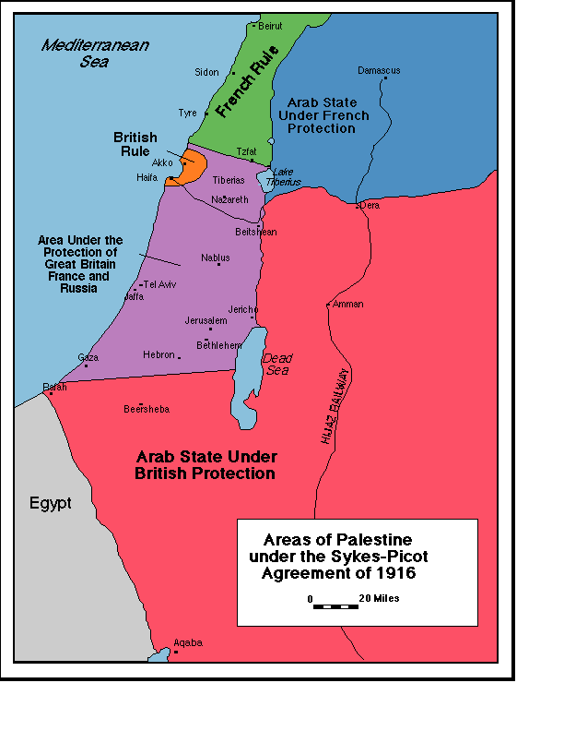
The Sykes-Picot agreement of 1916 was the first attempt by the League of Nations to create a separate Arab and Jewish State – It failed!

Slide 56
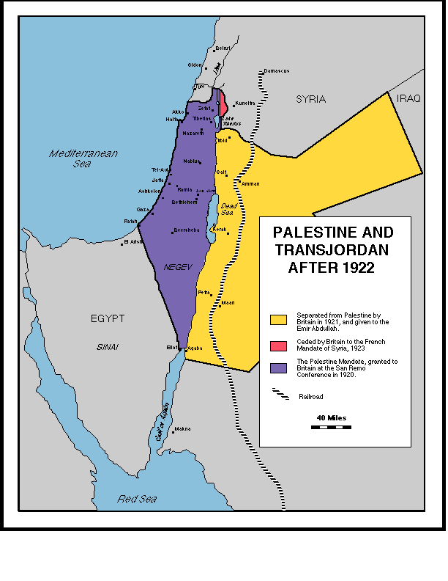
The Balfour Declaration (named after Lord Balfour of Britain) of 1917 eventually led to this division of the land to create a Jewish State and an Arab State with the intention of them being self governed. Many promises were made to both groups.
Then WWII broke out and disrupted things

Slide 57
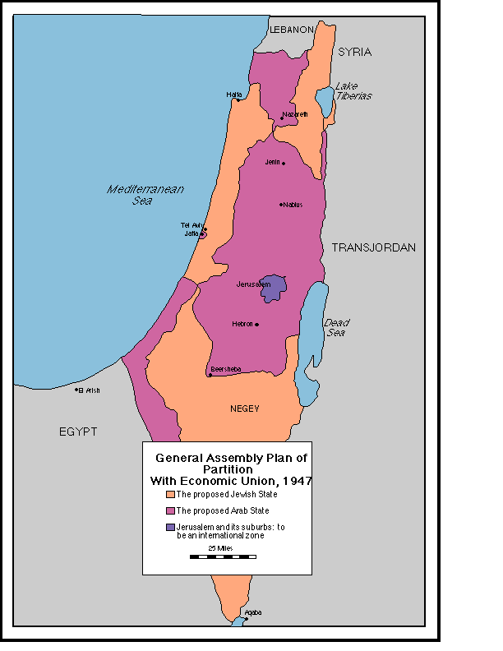
This was the plan drawn up by the United Nations in which they carved up the land in an attempt to create a Jewish State and an Arab in a much smaller land area than originally planned…..it was doomed for failure!

Slide 58
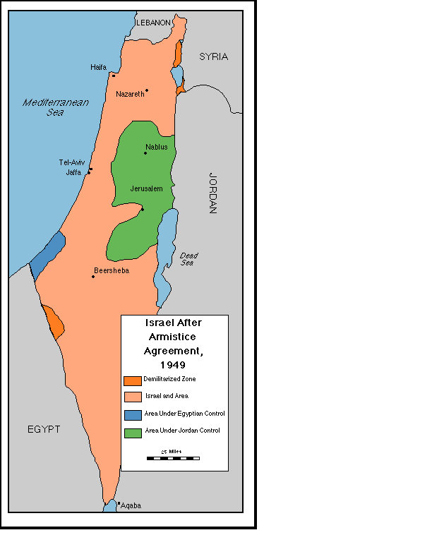
In 1948 the United Nations recognized the Jewish State of Israel as a sovereign State and war broke out immediately with the neighboring countries of Egypt, Jordan, and Syria. This is the division of the land at the conclusion of the 1948 War.

Slide 59
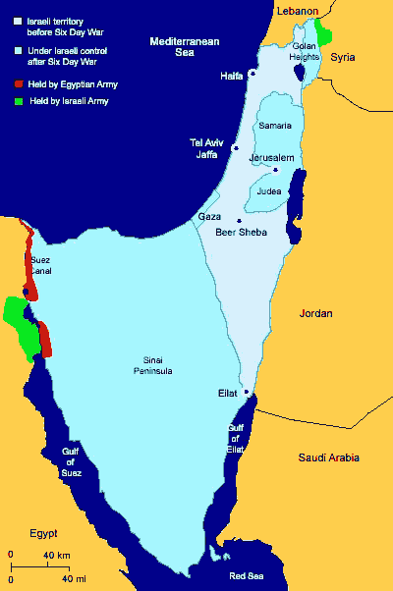
Israel fought another war in 1967 (Called the Six Day War) in which they defeated the combined orchestrated attacks led by Egypt, Syria, and Jordan in just six days. It was a humiliating defeat to the Arab world as Israel gained control of the entire Sinai Peninsula, the Gaza Strip, the West Bank, and the Golan Heights.

Slide 60
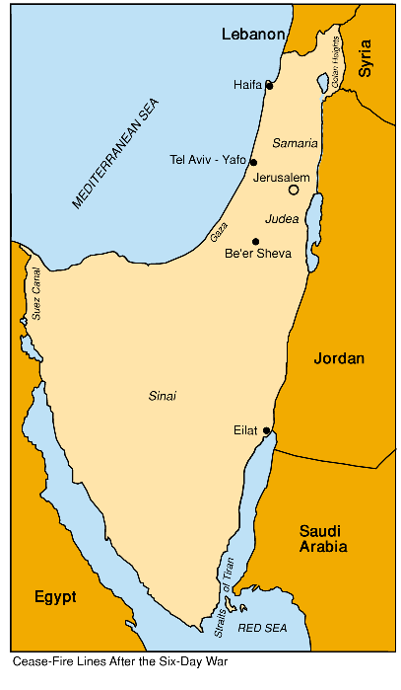
At the conclusion of the Six Day War, this was the Cease Fire Lines between Israel and its neighbors.
Since this was an embarrassment to the neighboring countries and to the entire Arab world, Egypt led yet another attack in 1973 called the Yom Kippur War in which they launched a sneak attack against Israel on their most holy day (The Day of Atonement).
Israel suffered the embarrassment of not being prepared as this invasion took them totally by surprise and they experienced numerous casualties. Israel was able to regroup and successfully defeat the Egyptian led attack and it led to a peace agreement between Israel and Egypt in 1973. Israel gave control of the Sinai Peninsula back to Egypt.

Slide 61
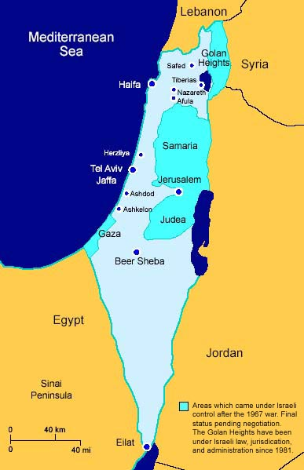
Modern Day Israel & Neighbors
Modern Israel stands at the crossroads of Europe, Asia and Africa. Geographically, it belongs to the Asian continent. Its western border is the Mediterranean Sea. To the north it is bound by Lebanon and Syria, to the east by Jordan and to the south by the Red Sea and Egypt. Long and narrow in shape, Israel is about 290 miles (470 km.) long and 85 miles (135 km.) across at its widest point. Its total area is 22,145 sq km, of which 21,671 sq km is land area.

Slide 63
Can we connect the Scriptural promises to what has happened and what is yet to happen?
“And behold you will conceive in your womb and bear a son, and you shall name Him Jesus. He will be great and will be called the Son of the Most High; and the Lord God will give Him the throne of His father David; and He will reign over the house of Jacob forever, and His kingdom will have no end” (Luke 1:31-33)

Slide 64
Can we connect the Old Testament promises to modern day events?
“Behold, the days are coming, declares the Lord, when I will fulfill the good word which I have spoken concerning the house of Israel and the house of Judah. In those days and at that time I will cause a righteous Branch of David to spring forth; and He shall execute justice and righteousness on the earth. In those days Judah will be saved and Jerusalem will dwell in safety; and this is the name by which she will be called: the Lord is our righteousness” (Jeremiah 33:14-16)

Slide 65
Future Fulfillment?
“My servant David will be king over them, and they will all have one shepherd; and they will walk in my ordinances and keep My statutes and observe them. They will live on the land that I gave to Jacob My servant, in which your fathers lived; and they will live on it, they, and their sons, and their sons’ sons, forever; and David My servant will be their prince forever. I will make a covenant of peace with them; it will be an everlasting covenant with them. And I will place them and multiply them, and will set my sanctuary in their midst forever. My dwelling place also will be with them; and I will be their God, and they will be My people. And the nations will know that I am the Lord, who sanctifies Israel, when My sanctuary is in their midst forever”. (Ezekiel 37:24-28)

Slide 66
Check this out!
“Then I saw a new heaven and a new earth…and the holy city coming down out of heaven from God…And I heard a loud voice from the throne saying, Behold the tabernacle of God is among men, and He will dwell among them, and they shall be His people and God Himself will be among them, and He will wipe away every tear from their eyes….”(Revelation 21:1-4)

Slide 67
Everyone will answer to the Lord
“For this reason also, God highly exalted Him, and bestowed on Him the name which is above every name, so that at the name of Jesus every knee will bow, of those who are in heaven and on earth and under the earth, and that every tongue will confess that Jesus Christ is Lord to the glory of God the Father” (Philippians 2:9-11)
“Behold, I am coming quickly, and My reward is with Me, to render to every man according to what he has done. I am the Alpha and Omega, the first and the last, the beginning and the end” (Revelation 22:13)

Slide 68
Jesus will return and everything will be made right!
“Be patient then brothers until the Lord’s coming. See how the farmer waits for the land to yield its valuable crop and how patient he is for the autumn and spring rains. You too be patient and stand firm, because the Lord’s coming is near. (James 5:7-8)

Slide 69
The
END

