Slide 1
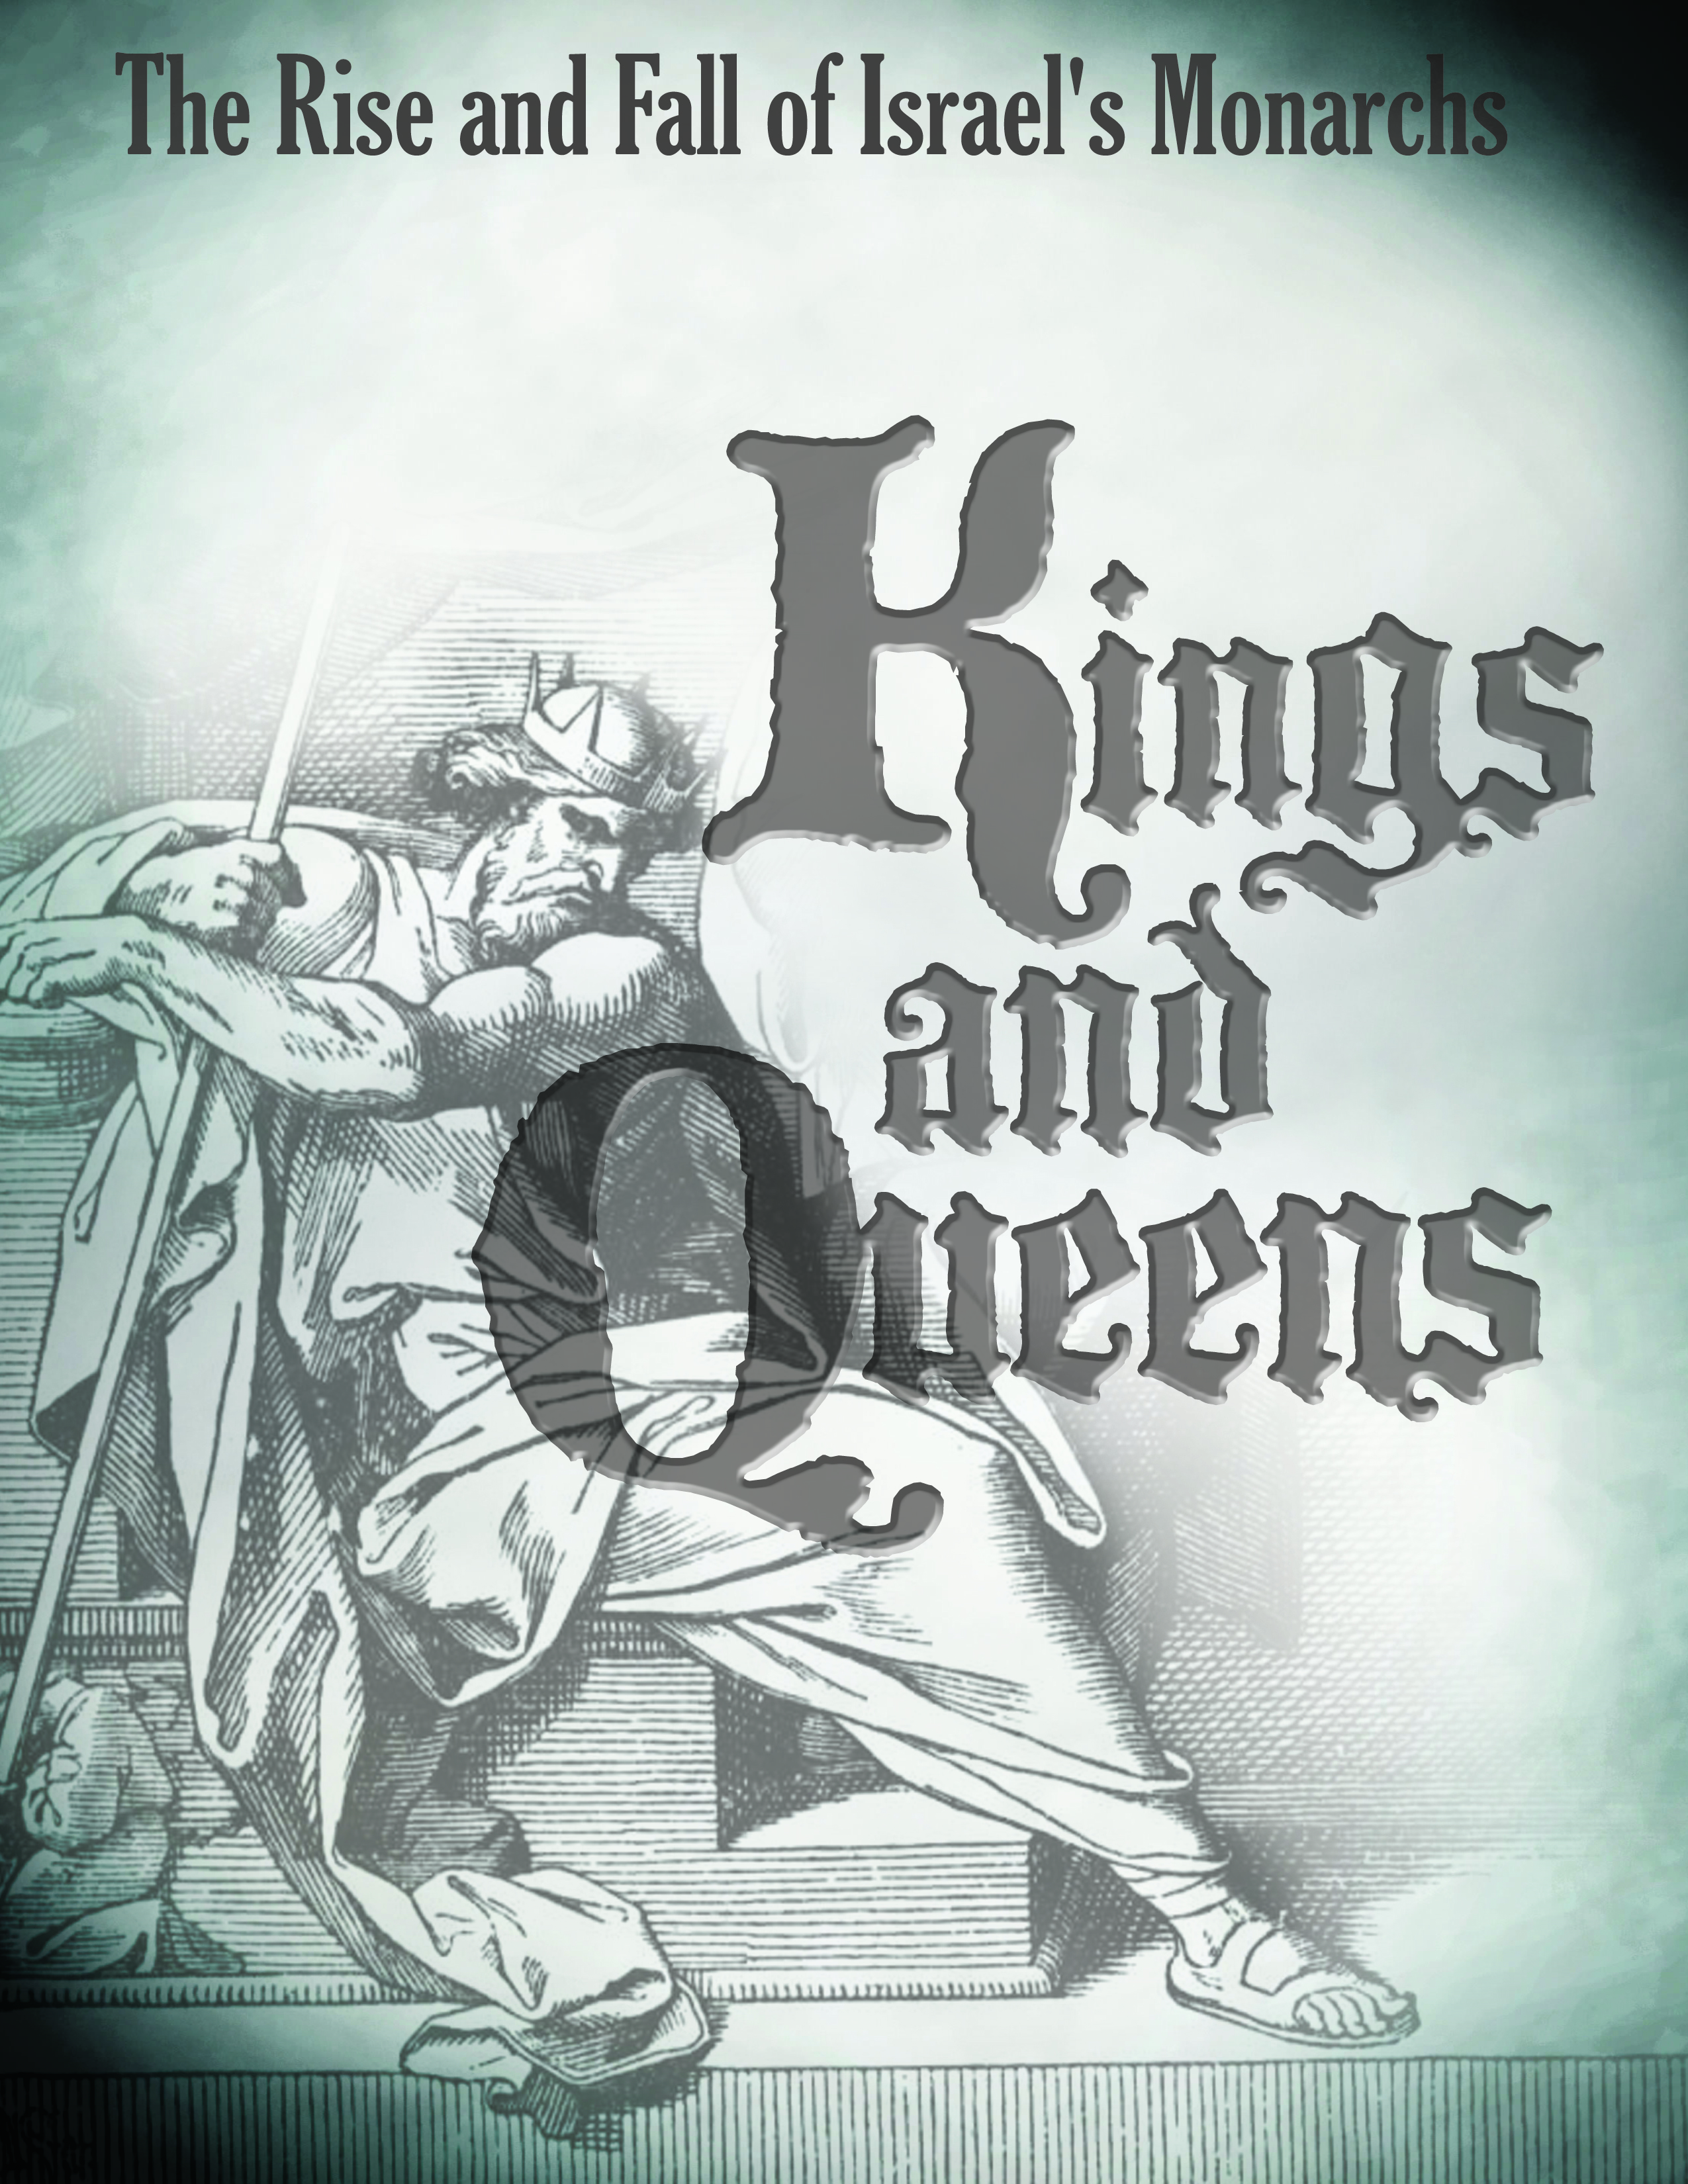
http://goodnewsbiblestudies.com

Slide 2
King Solomon
Selected
Scriptures

Slide 3
“It was pleasing in the sight of the Lord that Solomon had asked this thing. God said to him, because you have asked this thing and have not asked for yourself long life, nor have asked for riches for yourself, nor have you asked for the life of your enemies, but have asked for yourself discernment to understand justice, behold, I have done according to your words. Behold, I have given you a wise and discerning heart, so that there has been no one like you before you, nor shall one like you arise after you. I have also given you what you have not asked, both riches and honor so that there will not be any among the kings like you all your days. If you walk in my ways, keeping My statutes and commandments, as your father David walked, then I will prolong your days” (I Kings 3:10-13)

Slide 4
King Solomon
Solomon’s Birth
II Samuel 12:24-25

Slide 5
Solomon’s mother was Bathsheba
  Solomon’s birth came sometime after the death of David and Bathsheba’s first child (II Sam. 12:15-23)
  “Then David comforted his wife Bathsheba, and went into her and lay with her; and she gave birth to a son, and he named him Solomon. Now the Lord loved him and sent word through Nathan the prophet and he named him Jedidiah for the LORD’s sake” (II Samuel 12:24-25)
    Solomon means – peace
    Jedidiah means – loved of the Lord
Very little else is known about Solomon’s early childhood years

Slide 6
King Solomon
Solomon’s Beginnings

Slide 7
As David’s reign as king was coming to a close his preparation for the construction of the Temple and for the one who would succeed him became his primary focus.
  “David said, my son Solomon is young and inexperienced, and the house that is to be built for the Lord shall be exceedingly magnificent, famous and glorious throughout all lands. Therefore now I will make preparations for it. So David made ample preparations before his death.”
  (I Chronicles 22:5)

Slide 8
“Then he called for his son Solomon, and charged him to build a house for the Lord God of Israel. David said to Solomon, my son, I had intended to build a house to the name of the Lord my God. But the word of the Lord came to me, saying, you have shed much blood and have waged great wars; you shall not build a house to My name, because you have shed so much blood on the earth before Me. “
(I Chronicles 22:6-8)

Slide 9
“Behold, a son will be born to you, who shall be a man of rest; and I will give him rest from all his enemies on every side; for his name shall be Solomon, and I will give peace and quiet to Israel in his days. He shall build a house for My name, and he shall be My son, and I will be his father, and I will establish the throne of his kingdom over Israel forever.”
(I Chronicles 22:9-10)

Slide 10
David’s words to Solomon
  “Now my son, the Lord be with you that you may be successful, and build the house of the Lord your God just as He has spoken concerning you. Only the Lord give you discretion and understanding, and give you charge over Israel, so that you may keep the law of the Lord your God.” (I Chronicles 22:11-12)

Slide 11
David’s words to Solomon
  “Then you will prosper, if you are careful to observe the statutes and the ordinances which the Lord commanded Moses concerning Israel. Be strong and courageous, do not fear nor be dismayed” (I Chronicles 22:13)
  The key component in David’s charge to his son Solomon was for him to be faithful and obedient to the Lord and to the law (the statutes and ordinances). As long as Solomon remained true to the Lord – he would be blessed of the Lord.

Slide 12
David’s words to the leaders of Israel concerning Solomon and the Temple
  “Of all my sons (for the Lord has given me many sons), He has chosen my son Solomon to sit on the throne of the kingdom of the Lord over Israel. He said to me, your son Solomon is the one who shall build My house and My courts; for I have chosen him to be a son to Me, and I will be a father to him. I will establish his kingdom forever if he resolutely performs My commandments and My ordinances as is done now” (I Chronicles 28:5-7)

Slide 13
David’s words to Solomon
  What key words and actions can you identify from this passage that show what Solomon’s responsibility was toward the Lord?
  Know, serve, and seek God with his whole heart and willing mind
  What single action could Solomon do that would jeopardize his relationship with the Lord?
  To forsake the Lord would bring judgment

Slide 14
Solomon’s
Coronation as King
Solomon right to reign
as king over Israel:

Slide 15
First and foremost he was the Lord’s choice
  “Behold, a son will be born to you, who shall be a man of rest; and I will give him rest from all his enemies on every side; for his name shall be Solomon, and I will give peace and quiet to Israel in his days. He shall build a house for My name, and he shall be My son, and I will be his father, and I will establish the throne of his kingdom over Israel forever.” (I Chronicles 22:9-10)

Slide 16
First and foremost he was the Lord’s choice
  “Of all my sons (for the Lord has given me many sons), He has chosen my son Solomon to sit on the throne of the kingdom of the Lord over Israel. He said to me, your son Solomon is the one who shall build My house and My courts; for I have chosen him to be a son to Me, and I will be a father to him. I will establish his kingdom forever if he resolutely performs My commandments and My ordinances as is done now” (I Chronicles 28:5-7)

Slide 17
He was David’s choice:
  Of all of David’s sons, his choice to reign alongside of him during the final years of his life was Solomon. David made preparations for the construction of the temple and it would become Solomon’s task to complete.
  When an attempt was made by another of Solomon’s brothers (Adonijah) to take the throne – it was David who set the matter straight by declaring Solomon to be king of Israel. (I Kings 1:47-48)
He was embraced by the people of Israel to be their king (I Kings 1:39-40)

Slide 18
David’s final challenge to Solomon before he died; “I am going the way of all the earth. Be strong, therefore, and show yourself a man. Keep the charge of the Lord your God, to walk in His ways, to keep His statutes, His commandments, His ordinances, and His testimonies, according to what is written in the Law of Moses, that you may succeed in all that you do and wherever you turn, so that the Lord may carry out all his promises……” (I Kings 2:1-4)

Slide 19
Solomon
As King
Solomon’s initial reign as King of Israel begins (I Kings 2)

Slide 20
“Then David slept with his fathers and was buried in the city of David. The days that David reigned over Israel were 40 years: seven years he reigned in Hebron and thirty three years he reigned in Jerusalem. And Solomon sat on the throne of David his father, and his kingdom was firmly established”
(I Kings 2:10-11)

Slide 21
Solomon will reign as King of Israel for a total of 40 years (I Kings 11:42)
  During the reign of Solomon the temple will be built
  Israel will experience its greatest territorial expansion during Solomon’s reign
  Israel will be at relative peace with its neighbors during this period

Slide 22
During the early years of Solomon’s reign it was necessary for him to purge the leadership of sin and defilement and deal with some “unfinished” business left over from his father David’s reign.
  Adonijah – Solomon’s brother who initially attempted and subsequently failed to seize the throne around the time of David’s death (I Kings 1). Solomon graciously allowed him to live (although his actions were treasonous), but Adonijah continued to position himself to overthrow Solomon by requesting to marry Abishag (a member of David’s harem) and set himself up to make a formal claim to the throne. This request by Adonijah was understood by Solomon to be a further act of treason resulting in Adonijah’s death.
  Abiathar – formally removed from his priestly office because he sided with Adonijah.

Slide 23
During the early years of Solomon’s reign it was necessary for him to purge the leadership of sin and defilement and deal with some “unfinished” business left over from his father David’s reign.
  Joab – Once the head of David’s army and a mighty military leader was executed for his earlier actions in which he murdered Abner and Amasa. Joab also participated in Adonijah’s attempt to overthrow Solomon’s reign.
  Shimei – a potential threat to Solomon’s rule was initially allowed to live (though he had earlier cursed David and under judgment for his actions) in exile. Shimei violated the terms of his sentence and subsequently put to death.

Slide 24
Solomon’s chooses his closest advisors and important leaders in Israel
  Nathan the prophet
  Zadok the Priest – II Kings 2:35
  Benaiah (head of the royal bodyguard and military leader – II Kings 2:35)

Slide 25
Solomon worships the Lord and prepares to lead the people of Israel
  “Now Solomon the son of David established himself securely over his kingdom, and the Lord his God was with him and exalted him greatly. Solomon spoke to all Israel, to the commanders of thousands and of hundred and to the judges and to every leader in all Israel, the heads of the fathers households” (II Chronicles 1:1-2)
  The worship of the Lord (prior to the Temple) was to take place at the Tabernacle (also referred to as the Tent of Meeting) and as was customary, Solomon and the leaders of Israel made a pilgrimage to the Tabernacle which was located at Gibeon to offer sacrifices to the Lord. (II Chron. 1:3-6, I Kings 3:2-4)

Slide 26
Solomon worships the Lord and prepares to lead the people of Israel
  It was during this time of worship that the Lord appeared to Solomon in a dream and this resulted in a prayer by Solomon that completely changed his life and the course of history for the people of Israel for the next 40 years.
  The Lord says to Solomon; “Ask what you wish Me to give you” (I Kings 3:5)

Slide 27
Solomon
As King
Solomon’s Request and the Lord’s Response

Slide 28
“Then Solomon said, you have shown great lovingkindness to Your servant David my father, according as he walked before you in truth and righteousness and uprightness of heart toward You; and You have reserved for him this great lovingkindness, that you have given him a son to sit on his throne, as it is this day” (I Kings 3:6)

Slide 29
“Now, O Lord My God, You have made Your servant king in place of my father David, yet I am but a little child; I do not know how to go out or come in. Your servant is in the midst of Your people which You have chosen, a great people who are too many to be numbered or counted. So give Your servant an understanding heart to judge Your people to discern between good and evil. For who is able to judge this great people of Yours”
(I Kings 3:7-9)

Slide 30
The reference to him being a child is probably another way of saying he understood that he was inexperienced in comparison to his father David.
Solomon appeared to have both a sense of humility and an unassuming nature about him which lent itself to a soft heart toward the Lord and a genuine willingness to seek His direction and blessing – very similar to David.

Slide 31
The overwhelming task of leading the people of Israel was not taken lightly by Solomon and the need for wisdom and discernment was clearly his focus.
  Take note of the fact that Solomon acknowledges that the Lord chose Israel
  Another thing worth noting is Solomon knew full well that the source of wisdom and discernment came directly from the Lord, something that Solomon would write about throughout the various Proverbs.
  Ever since the days of Moses when he led the Israelites out of bondage in Egypt, the Israelite people had been a challenge to lead and Solomon was well aware of this enormous responsibility he was taking on in leading the people of God.

Slide 32
The desire for an understanding heart to judge the people and discern between good and evil was something that Solomon knew he needed from the Lord.

Slide 33
The Lord answered:
“It was pleasing in the sight of the Lord that Solomon had asked this thing. God said to him, because you have asked this thing and have not asked for yourself long life, nor have asked for riches for yourself, nor have you asked for the life of your enemies, but have asked for yourself discernment to understand justice, behold, I have done according to your words. Behold I have given you a wise and discerning heart, so that there has been no one like you before you, nor shall one like you arise after you” (I Kings 3:10-12)

Slide 34
The Lord answered:
This request by Solomon; for wisdom and understanding, pleased the Lord because it was an acknowledgment that he was more interested in the eternal things of the Lord and not just the temporal things found in this world.
The wisdom that the Lord grants to Solomon will cause him to write these words that are recorded in Proverbs; “The fear of the Lord is the beginning of knowledge; fools despise wisdom and instruction” (Proverbs 1:7)

Slide 35
The Lord answered:
The pursuit of wisdom by Solomon is also recorded here;
“My son, if you will receive my words and treasure my commandments within you, make your ear attentive to wisdom, incline your heart to understanding; for if you cry for discernment, lift your voice for understanding; if you seek her as silver and search for her as hidden treasures; then you will discern the fear of the Lord and discover the knowledge of God. For the Lord gives wisdom; from His mouth comes knowledge and understanding. He stores up sound wisdom for the upright; He is a shield to those who walk in integrity, guarding the paths of justice, and He preserves the way of His godly ones” (Proverbs 2:1-8)

Slide 36
The Lord answered:
In this Proverb; Solomon expresses the benefit and blessings that are a result of wisdom and of following the Lord: “Trust in the Lord with all your heart and do not lean on your own understanding. In all your ways acknowledge Him and He will make your paths straight” (Proverbs 3:5-6)
Solomon expresses the value of wisdom; “How blessed is the man who finds wisdom and the man who gains understanding. For her profit is better than the profit of silver and her gain better than fine gold. She is more precious than jewels and nothing you desire compares with her” (Prov. 3:13-15)

Slide 37
The Lord answered:
“I have also given you what you have not asked for, both riches and honor, so that there will not be any among the kings like you all your days” (I Kings 3:13)
Since Solomon placed such a high value on wisdom and discernment and since he made that his primary request, then the Lord also granted him “riches and honor” which was of secondary importance but it will aid him in governing the people of Israel.
It became true that in Solomon’s day that he was known for his wisdom but also for his wealth.

Slide 38
“If you walk in My ways, keeping My statutes and commandments, as your father David walked, then I will prolong your days. (I Kings 3:14)
The immense amount of wealth and stature that Solomon was blessed with becomes the snare that will entrap him and will eventually cause his fall.
Like his father David, he will struggle with complete obedience to the Lord, but in the case of Solomon, he will delve much farther into a number of sinful practices that will ultimately cause future damage to the Kingdom of Israel.
The condition of “keeping My statutes and commandments” was something that became a challenge for Solomon and as such the promise of a long and fruitful life for Solomon was never fulfilled.

Slide 39
“Then Solomon awoke, and behold, it was a dream. And he came to Jerusalem and stood before the ark of the covenant of the Lord, and offered burnt offerings and made peace offerings, and made a feast for all his servants” (I Kings 3:15)

Slide 40
Solomon
As King
Solomon’s Display of His Will, Wealth, and Wisdom

Slide 41
Solomon rules as King of Israel and his domination of the surrounding nations and kingdoms shows the tremendous power and will of his reign

Slide 42
In order for this to take place, Solomon first needed to establish his authority which he did by building a strong team of leaders to govern what would develop into and become known as the united kingdom of Israel. (I Kings 4:1-19)

Slide 43
“Now Solomon ruled over all the kingdoms from the River to the land of the Philistines and to the borders of Egypt; they brought tribute and served Solomon all the days of his life” (I Kings 4:21)
  During Solomon’s reign; the Euphrates River served as the north and eastern boundaries of the kingdom, the land of the Philistines served as the western boundary, and the land of Egypt served as the southern boundary.
  Some of the territories and lands described here remained as lands allocated to other nations and kingdoms but those kingdoms were under the control of Solomon’s kingdom and they paid taxes to him.

Slide 44
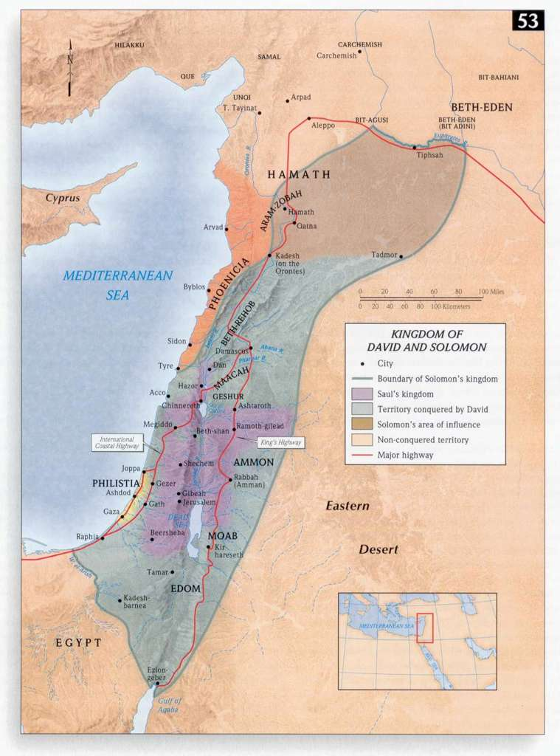

Slide 45
The actual defined borders of the kingdom of Israel during this time are described in I Kings 4:25; “So Judah and Israel lived in safety, every man under his vine and his fig tree, from Dan, even to Beersheba, all the days of Solomon”

Slide 46
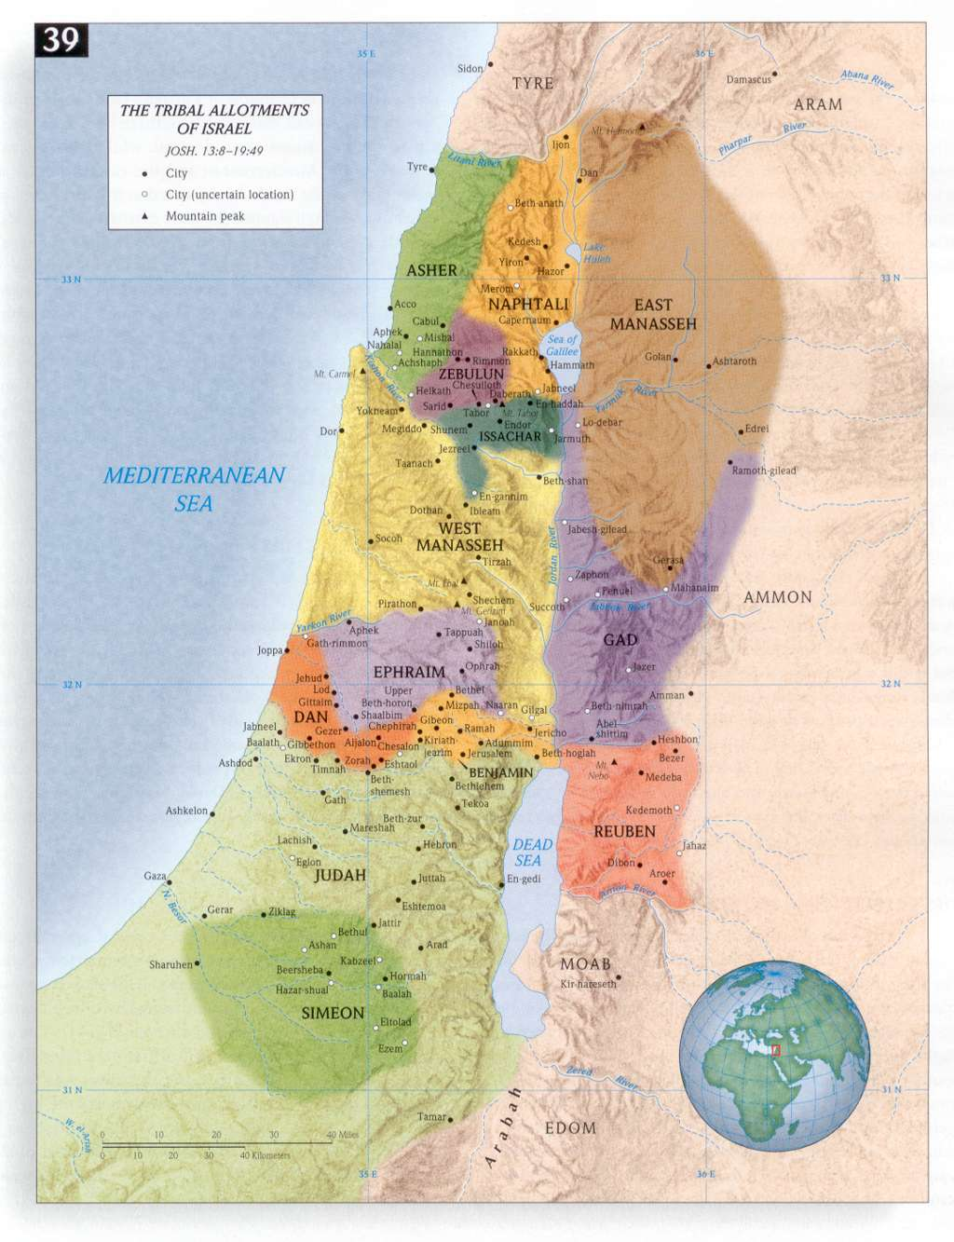

Slide 47
Solomon’s wealth was beyond compare and his wisdom was unmatched by any other:
  12,000 horses, 1400 chariots, his annual revenue of gold alone was recorded to be 25 tons, his throne was made of ivory and overlaid in refined gold.
  “So King Solomon became greater than all the kings of the earth in riches and in wisdom. All the earth was seeking the presence of Solomon, to hear his wisdom which God had put in his heart” (I Kings 10:23-24)
  He spoke 3000 proverbs (several hundred preserved in the Books of Proverbs and Ecclesiastes), wrote 1005 songs (one was recorded as The Song of Songs) and he was an expert in botany and zoology. (I Kings 4:32-34)

