Slide 1
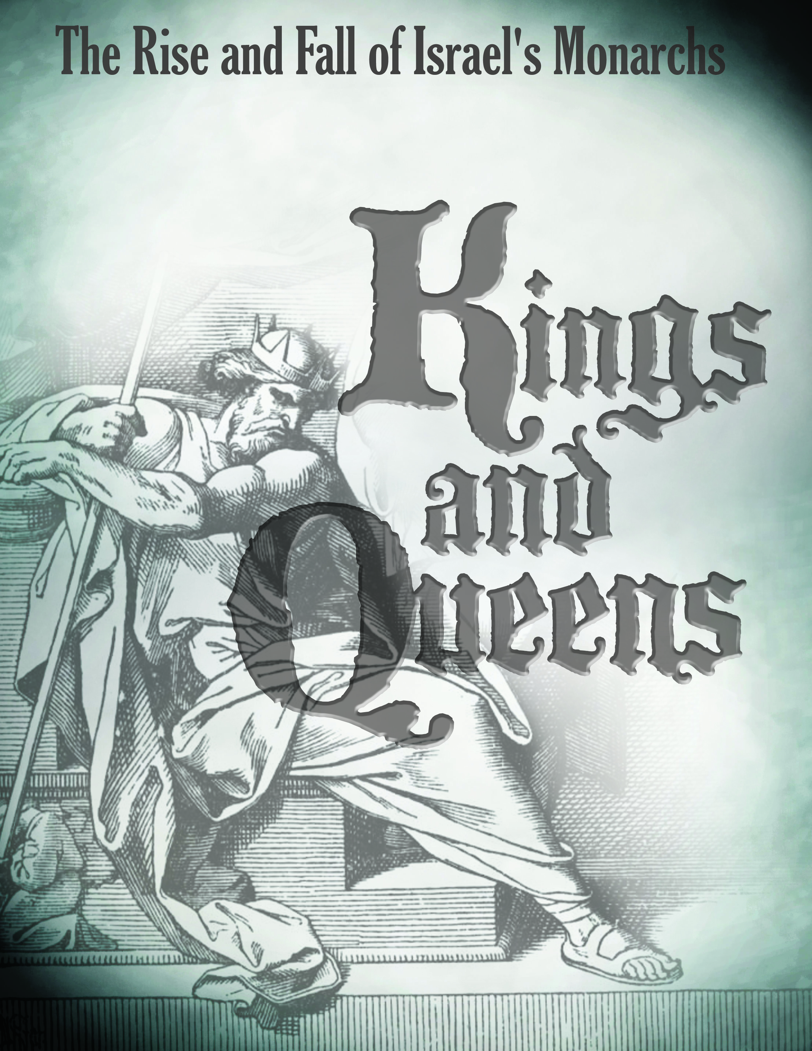
http://goodnewsbiblestudies.com

Slide 2
A Divided Kingdom
King Jeroboam
& King Rehoboam

Slide 3
“The people of Israel and Judah have provoked Me by all the evil they have done – they, their kings and officials, their priests and prophets, the men of Judah and the people of Jerusalem. They turned their backs to Me and not their faces; though I taught them again and again, they would not listen or respond to discipline. They set up their abominable idols in the house that bears My Name and defiled it” (Jeremiah 32:32-34)

Slide 4
Introduction:
Upon the death of Solomon the United Kingdom of Israel will divide along similar lines that existed prior to the reign of King David. (Approx. 931 B.C.)

Slide 5
The Northern 10 tribes of Israel will follow Jeroboam (from the tribe of Ephraim) who was one of Solomon’s servants.
  Initially the capital or central location of the Northern Kingdom is Shechem and the capital will later be moved to Samaria.
  The Northern Kingdom will have a succession of 19 kings (all bad) before they are conquered by the Assyrians in 721 B.C

Slide 6
The Southern 2 tribes (Judah and Benjamin) will follow Solomon’s son Rehoboam.
  The capital of the Southern Kingdom is Jerusalem
  The Southern Kingdom will have a succession of 19 kings and 1 queen (some good and some bad) before they are conquered by Babylon in 586 B.C.

Slide 7
Introduction:
During the time of the Divided Kingdom (Northern and Southern Kingdom) the prophet will become the voice or spokesperson for the Lord to the people

Slide 8
The prophets who spoke to the people and kings of the Northern Kingdom before they were conquered by the Assyrians and went into captivity:
  Elijah (approx. 885-841 B.C.)
  Elisha (approx. 841-782 B.C.)
  Hosea (approx. 793-722 B.C)
  Jonah (approx. 793-753 B.C.)
  Amos (approx. 793-753 B.C.)

Slide 9
The prophets who spoke to the people and kings of the Southern Kingdom before they were conquered by the Babylonians and went into captivity:
  Obadiah (approx. 848-841 B.C.)
  Joel (approx. 835-796 B.C.)
  Isaiah (approx. 750-642 B.C.)
  Micah (approx. 750-686 B.C.)
  Nahum (approx. 697-642 B.C.)
  Jeremiah (approx. 640-597)
  Zephaniah (approx. 640-609 B.C.)
  Habakkuk (approx. 609-598 B.C.)

Slide 10
Introduction:
The other group that helped to lead the people of God were the priests. These men would play a more important role after the return from Babylonian captivity.

Slide 11
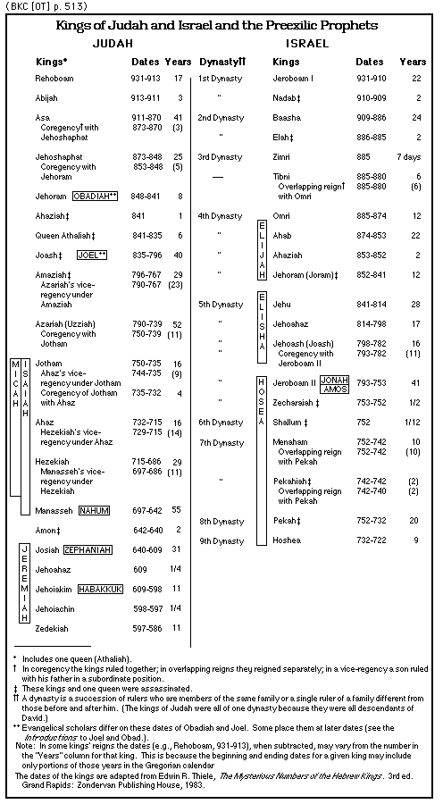

Slide 12
King Jeroboam (931-910 B.C)
A little background on Jeroboam

Slide 13
He was a descendant from the tribe of Ephraim which was the strongest of the tribes of the “Northern Kingdom of Israel”.
  Ephraim was not one of Jacob’s 12 children – he was actually one of Joseph two sons. The other son of Joseph was Manasseh.
  Just as a side note – the reason that Ephraim and Manasseh were included as two of the 12 tribes who received designated territories within the land promised to Abraham and later confirmed to Jacob is because Levi was to receive no territorial allotment (they were a special lineage of priests and the Lord chose not to assign them any specific territory) and Reuben (Jacob’s first born) had lost his privileged inheritance for sleeping with Bilhah (Jacob’s concubine). Joseph’s territories were assigned to Ephraim and Manasseh.

Slide 14
The scriptures mention that Jeroboam was a valiant warrior (I Kings 11:28) which would explain his later abilities to lead the 10 tribes of the north.
He is referred to as one of Solomon’s servants and became recognized by Solomon for his good work. Solomon actually promoted him to be in charge of the entire labor force.

Slide 15
The prophet Ahijah will tells Jeroboam of the division of the kingdom that is about to take place (I Kings 11:29-33) and that he would rule the 10 tribes of the Northern Kingdom of Israel.
  “Then Ahijah took hold of the new cloak which was on him and tore it into twelve pieces. He said to Jeroboam, take for yourself ten pieces; for thus says the Lord God of Israel, behold, I will tear the kingdom out of the hand of Solomon and give you ten tribes” (I Kings 11:30-31)
  “Solomon sought therefore to put Jeroboam to death; but Jeroboam arose and fled to Egypt to Shishak king of Egypt, and he was in Egypt until the death of Solomon” (I Kings 11:40)

Slide 16
King Jeroboam (931-910 B.C)
A missed opportunity

Slide 17
Jeroboam (a descendant from the lineage of Ephraim) was not a descendant from the line of Judah as was Solomon and his son Rehoboam.
  This is important to note because the royal lineage was to come from the tribe of Judah (Genesis 49:10) and David was a descendant from that tribe.
  The Lord made an unconditional promise to David that his house (lineage) would be established forever (II Samuel 7:16) and it would be from his royal lineage from whom the Messiah would be born.

Slide 18
Jeroboam (a descendant from the lineage of Ephraim) was not a descendant from the line of Judah as was Solomon and his son Rehoboam.
  It was because of Solomon’s disobedience that the Lord stripped the kingdom away from Solomon and made a conditional promise to Jeroboam that he would rule Israel, and also have an enduring house (lineage) as David, if he was obedient to the Lord’s commands.
  “Then it will be, that if you listen to all that I command you and walk in My ways, and do what is right in My sight by observing My statutes and My commandments, as My servant David did, then ﻿﻿I will be with you and ﻿build you an enduring house as I built for David, and I will give Israel to you.” (I Kings 11:38)

Slide 19
The promises that the Lord made to David had not changed and the ultimate fulfillment of those promises would come through the birth of Jesus Christ, but because of Solomon’s sin and disobedience the judgment of the Lord came in the form of a divided kingdom.
  Had Jeroboam been obedient and followed the Lord with his whole heart, then things might have turned out different for him and his descendants.
  Instead (as we will see) Jeroboam will not follow the Lord and his sins will exceed those of Solomon. This will set a course of continued disobedience for those kings that succeed Jeroboam and rule the Northern Kingdom of Israel.
The Lord’s plans remain unchanged, but Jeroboam’s missed opportunity is a stark reminder of the Lord’s expectations and requirements of obedience as we will see

Slide 20
King Jeroboam (931-910 B.C)
The formal division of the kingdom happens after the death of Solomon

Slide 21
“And Solomon ﻿﻿slept with his fathers and was buried in the city of his father David, and his son Rehoboam reigned in his place. Then Rehoboam went to Shechem, for all Israel had come to Shechem to make him king” (I Kings 11:43, I Kings 12:1)
  Rehoboam was the natural successor to the throne upon the death of Solomon
  Rehoboam came to Shechem as that was the primary gathering point for the ten tribes of the north (Israel).
  Rehoboam’s purpose in going to Shechem was to solidify his authority over the northern 10 tribes. Jerusalem was the headquarters of the two southern tribes (Judah and Benjamin) from where Rehoboam already ruled.

Slide 22
“Now ﻿﻿when Jeroboam the son of Nebat heard of it, he was living in Egypt (for he was yet in Egypt, where he had fled from the presence of King Solomon). Then they sent and called him, and Jeroboam and all the assembly of Israel came and spoke to Rehoboam, saying, your father made our yoke hard; now therefore lighten the hard service of your father and his heavy yoke which he put on us, and we will serve you”. (I Kings 12:2-4)
  Jeroboam returned from Egypt to his homeland and the people of northern ten tribes of Israel looked to him for leadership instead of Rehoboam.
  Rehoboam was not interested in the well-being of the people and was more interested in overworking and overtaxing them. This brought rebellion and insurrection from the 10 tribes of Israel against Rehoboam.

Slide 23
“It came about when all Israel heard that Jeroboam had returned, that they sent and called him to the assembly and made him king over all Israel. None but the tribe of Judah followed the house of David.” (I Kings 12:20)
  The 10 tribes of the north (Northern Kingdom of Israel) followed Jeroboam
  The 2 tribes of the south (Southern Kingdom of Judah) followed Rehoboam

Slide 24
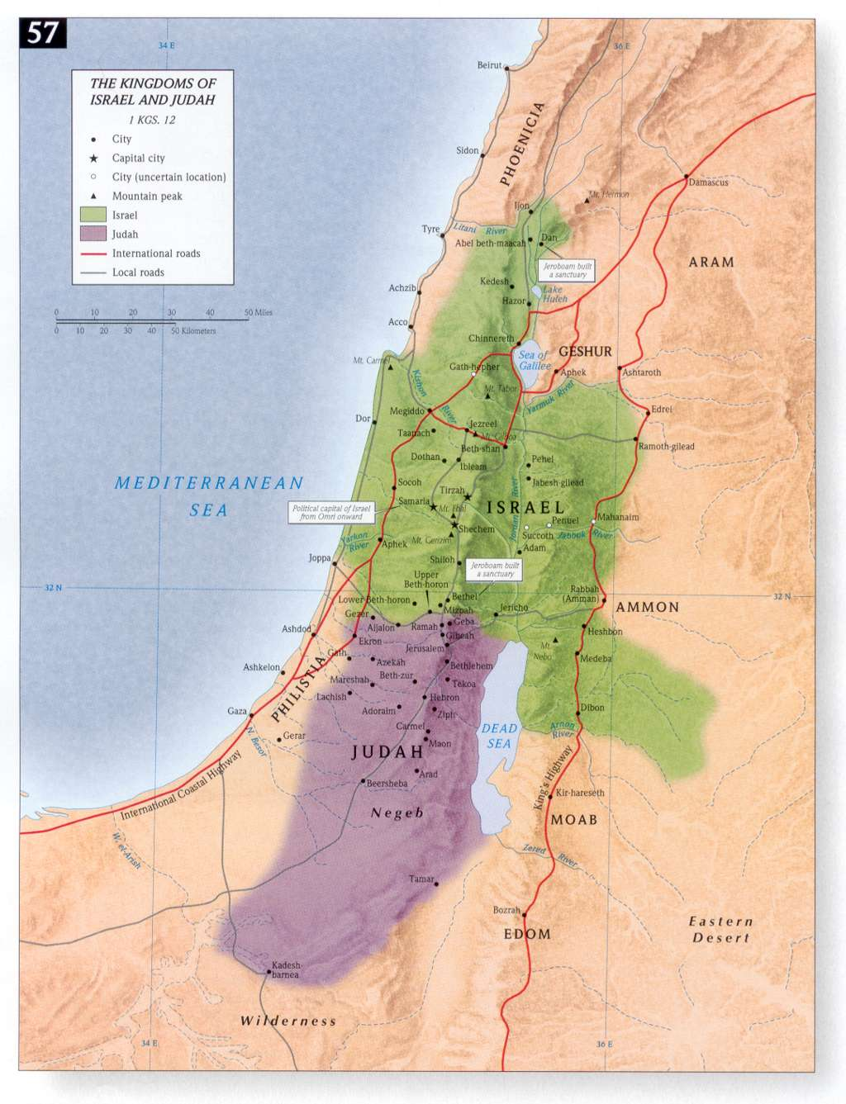

Slide 25
King Jeroboam (931-910 B.C)
Jeroboam’s Rebellion
(I Kings 13:25-33)

Slide 26
Jeroboam establishes the city of Shechem as the primary headquarters of the Northern Kingdom:
  “Then ﻿﻿Jeroboam built Shechem in the hill country of Ephraim, and lived there. And he went out from there and built Peniel.” (I Kings 13:25)
  It’s ironic that he chose Shechem as his capitol since it is the same location where Rehoboam was crowned as king.
  Jeroboam’s choice to make Shechem as the headquarter was intentional and planned to draw attention away from Jerusalem where the Temple was located
  Jeroboam was fearful that the hearts of the people would turn to Rehoboam and to the city of Jerusalem so he provides an alternative center of authority and an alternative place of worship.

Slide 27
Jeroboam led the people down a path of idolatry and rebellion against the Lord:
  “So the king consulted, and ﻿made two golden calves, and he said to them, It is too much for you to go up to Jerusalem; ﻿behold your gods, O Israel, that brought you up from the land of Egypt. He set one in Bethel, and the other he put in Dan.” (I Kings 12:28-29)
  “Now this thing became a sin, for the people went to worship before the one as far as Dan. And he made houses on high places, and ﻿﻿made priests from among ﻿﻿all the people who were not of the sons of Levi.” (I Kings 12:30-31)

Slide 28
Jeroboam led the people down a path of idolatry and rebellion against the Lord:
  “Jeroboam instituted a feast in the eighth month on the fifteenth day of the month, like the feast which is in Judah, and he went up to the altar; thus he did in Bethel, sacrificing to the calves which he had made. And he stationed in Bethel the priests of the high places which he had made. Then he went up to the altar which he had made in Bethel on the fifteenth day in the eighth month, even in the month which he had ﻿devised ﻿in his own heart; and he instituted a feast for the sons of Israel and ﻿went up to the altar ﻿to burn ﻿incense.” (I Kings 12:32-33)

Slide 29
Jeroboam’s actions evidenced a wicked heart of unbelief and a complete lack of faith and trust in the Lord which will bring judgment upon him.
  The first thing that Jeroboam did was to make two golden calves (or bulls) for the intended purpose of making these idols the object of their worship and turning the people’s hearts away from worshipping the Lord. This will later be openly condemned by the prophet Hosea (Hosea 8:5-6, 13:2-3).
  The second thing that Jeroboam did was to build new houses of worship (in high places) to replace the need to go to Jerusalem where the temple was located to honor the Lord and have ones sins atoned for.

Slide 30
Jeroboam’s actions evidenced a wicked heart of unbelief and a complete lack of faith and trust in the Lord which will bring judgment upon him.
  The third things that Jeroboam did was to appoint his own set of priests who were not descendants of Levi (the tribe from whom the Lord declared to be priests and able to conduct priestly activities) and who had no real spiritual background or qualifications.
  The fourth thing that Jeroboam did was to institute his own festivals that were more tied to pagan gods and not the required feasts and festivals that the Lord required them to observe.

Slide 31
Each of these practices put into place by Jeroboam were intentional and the purpose was to draw the hearts of the people away from the One True God!
  Jeroboam actually researched the other false pagan religion and used those findings to put his evil plan in place.
  These actions polluted and stained the people of the northern tribes of Israel for generations and they ultimately lost their identity and standing as a people who once worshipped God and God alone!
  Many of the true Levitical priests of the northern tribes would have nothing to do with these false practices and moved to the southern territory of Judah, as they recognized this apostasy and departure from the truth.

Slide 32
These changes made by Jeroboam made it easier for the people to worship as they pleased and the desire for their former way of true worship diminished.

Slide 33
King Jeroboam (931-910 B.C)
Jeroboam and his family face judgment
(I Kings 14)

Slide 34
“Go, say to Jeroboam, Thus says the Lord God of Israel, because I exalted you from among the people and made you leader over My people Israel, and ﻿tore the kingdom away from the house of David and gave it to you; yet you have not been like My servant David, who kept My commandments and who followed Me with all his heart, ﻿to do only that which was right in My sight;” (I Kings 14:7-8)

Slide 35
“You also have done more evil than all who were before you, and have gone and made for yourself other gods and molten images to provoke Me to anger, and have cast Me behind your back; therefore behold, I am bringing calamity on the house of Jeroboam, and will cut off from Jeroboam every male person, both bond and free in Israel, and I will make a clean sweep of the house of Jeroboam, as one sweeps away dung until it is all gone.” (I Kings 14:9-10)
  Jeroboam’s pursuit of idolatry was his major downfall
  His active rebellion against the Lord also brought judgment to his family

Slide 36
“Anyone belonging to Jeroboam who dies in the city the dogs will eat. And he who dies in the field the birds of the heavens will eat; for the Lord has spoken it.” (I Kings 14:11)
“Moreover, the Lord will raise up for Himself a king over Israel who will cut off the house of Jeroboam this day and from now on. For the Lord will strike Israel, as a reed is shaken in the water; and ﻿He will uproot Israel from this good land which He gave to their fathers, and will scatter them beyond the Euphrates River, because they have made their Asherim, provoking the Lord to anger. He will give up Israel on account of the sins of Jeroboam, which he committed and with which he made Israel to sin.” (I Kings 14:14-16)

Slide 37
Jeroboam was clearly a very powerful man who managed to draw the 10 tribes of Israel to follow him and he successfully ruled the Northern Kingdom for some time. His reign lasted a total of 22 years and his son Nadab succeeded him to the throne of Israel.
Jeroboam’s downfall was in his lack of commitment to the Lord. Had he been obedient to the Lord, then he might have been a blessed and spiritually effective king.

Slide 38
King Rehoboam (931-917 B.C)
A little background on Rehoboam:

Slide 39
His mother was Naamah (I Kings 14:21)
  She was an Ammonite (descendant of Ammon – son of Lot and his daughter)
  She was one of Solomon’s many foreign wives and she probably worshipped the pagan god Molech.
  Many Bible scholars conclude that she was very influential in re-establishing Canaanite worship of false deities during Rehoboam’s reign.

Slide 40
His father of course was Solomon
  This would make him from the royal lineage of Judah
  With all of Solomon’s wives he must have had others sons but Rehoboam was the only one mentioned and the one who succeeded Solomon to the throne.

Slide 41
There is no evidence of any spiritual interest, no special relationship with any of the prophets and no covenantal promises from the Lord were made to Rehoboam.
With all of Solomon’s personal failures and the influence of various pagan rituals and practices, Rehoboam’s life will echo his apparent upbringing.
He (like all of the kings of the Southern Kingdom of Judah) will reign from Jerusalem which (until the division of the kingdom) was the religious and political center during the reign of his father and grandfather for approx. 73 years.

Slide 42
Rehoboam will begin his reign as king at the age of 41 and he will reign a total of 17 years (931 B.C. to 913B.C)
Shortly after Rehoboam begins his reign there is dissention in the ranks and he heads to Shechem (the unofficial headquarters of the northern tribes) to be crowned. His leadership is questioned by Jeroboam and the kingdom divides.

Slide 43
King Rehoboam (931-917 B.C)
Rehoboam clearly lacked the wisdom of his father Solomon:

Slide 44
﻿“Then Rehoboam went to Shechem, for all Israel had come to Shechem to make him king. Now ﻿﻿when Jeroboam the son of Nebat heard of it, he was living in Egypt (for he was yet in Egypt, where he had fled from the presence of King Solomon). Then they sent and called him, and Jeroboam and all the assembly of Israel came and spoke to Rehoboam, saying, ﻿Your father made our yoke hard; now therefore lighten the hard service of your father and his heavy yoke which he put on us, and we will serve you.” (I Kings 12:1-4)

Slide 45
This event happened shortly after the death of Solomon and just prior to the division of the kingdom.
If you recall Rehoboam went to Shechem to be crowned as king over what was still a United Kingdom of Israel.
Jeroboam (who had not yet led the people of the 10 tribes of Israel into rebellion) had returned from Egypt (Solomon had planned to put him to death) and gathered the ten tribes of Israel to air their grievances with Rehoboam.
The request of Jeroboam and the ten tribes of Israel were simple; stop overworking and overtaxing your people and we will serve you.

Slide 46
﻿Rehoboam took several days to consider their proposal and he even counseled with the elders (many of them trusted advisors to his father Solomon) who advised Rehoboam to do as they requested and maintain peace and harmony.

Slide 47
Rehoboam’s decision was most foolish:
  “The king answered the people harshly, for he forsook the advice of the elders which they had given him, and he spoke to them according to the advice of the young men, saying, my father made your yoke heavy, but I will add to your yoke; my father disciplined you with whips, but I will discipline you with scorpions.” (I Kings 12:13-14)
  This action by Rehoboam is what brought the division between the northern ten tribes of Israel and the southern two tribes of Judah.

Slide 48
King Rehoboam (931-917 B.C)
Rehoboam reigns over the Southern Kingdom of Judah (931-913 B.C.)

Slide 49
﻿“Now Rehoboam the son of Solomon reigned in Judah. Rehoboam was forty-one years old when he became king, and he reigned seventeen years in Jerusalem, the city which the Lord had chosen from all the tribes of Israel to put His name there. And his mother’s name was Naamah the Ammonitess.” (I Kings 14:21)
  It is probably good to note the location of Rehoboam’s rule which was the city of Jerusalem, a place chosen by the Lord and in contrast to the cities of Shechem and Samaria which were places chosen by men from which the kings of the North would rule.
  The other important item to note from this text is Rehoboam’s mother who was an Ammonite and she clearly influenced her son toward pagan deities and idol worship which resulted in his downfall and the downfall of the Southern kingdom of Judah for a season of time

Slide 50
These passages describe the spiritual condition of Rehoboam and the people of the Southern Kingdom of Judah:
  ﻿“Judah did evil in the sight of the Lord, and they provoked Him to jealousy more than all that their fathers had done, with ﻿﻿the sins which they ﻿﻿committed.” (I Kings 14:22)
  “For they also built for themselves high places and sacred ﻿﻿pillars and Asherim on every high hill and ﻿﻿beneath every luxuriant tree. There were also male cult prostitutes in the land. They did according to all the abominations of the nations which the Lord dispossessed before the sons of Israel.” (I Kings 14:23-24)

Slide 51
Rehoboam had turned from the Lord and he reintroduced many of the pagan and wicked practices that existed during the time of the Judges in which “every person did what was right in their own eyes” (Judges 2:11-17)
  ﻿“He did evil because he did not set his heart to seek the Lord”. (I Chr. 12:14)
  During Rehoboam’s reign he was in constant warfare against Jeroboam

Slide 52
There are no records at our disposal that describe King Rehoboam’s reign as anything other than an evil and wicked ruler who forsook the Lord and squandered an opportunity to unite the kingdom rather than divide it.
Rehoboam died at a young age of 58 with a brief statement telling us he was buried with his fathers in the city of Jerusalem.
What a missed opportunity and a wasted life!

Slide 53
Closing Remarks
Solomon’s decisions to marry foreign women, follow after their gods, and allow open worship of these pagan deities clearly impacted his son Rehoboam in a negative way.

Slide 54
It really is a sad testimony for Solomon as he was given so much and yet he chose to allow himself to be sidetracked and influenced by wickedness. This evil influence is what drove the kingdom to divide.
  The Northern tribes of Israel followed Jeroboam who drove those tribes even further into wickedness, perversion, and idolatry.
  The Southern tribes followed Rehoboam and they too pursued the same wicked practices and idolatry that the Northern Kingdom followed.

Slide 55
The remaining two lessons of our study will focus on each kingdom (the Northern Kingdom of Israel and the Southern Kingdom of Judah) and the kings associated with those two kingdoms.
  The kings of the Northern Kingdom of Israel (19 in all) were all wicked and eventually the Northern Kingdom was defeated by the Assyrians. The people were taken captive by the Assyrians and never recovered or fully returned to their land, nor did they repent and return to the Lord.
  The kings of the Southern Kingdom of Judah (19 + 1 Queen) were mostly wicked but some followed the Lord. Eventually the Southern Kingdom was defeated by the Babylonians and taken captive. They did eventually repent and returned to their land, rebuilt the Temple and worshipped the Lord once again.

